Slide 1
Spanish Fork High School
Class of 1965
Elementary School Class Pictures
Benjamin
Lake Shore
Central
Park
Rees
Salem
Thurber

Slide 2
Benjamin Elementary School
Benjamin, Utah

Slide 3
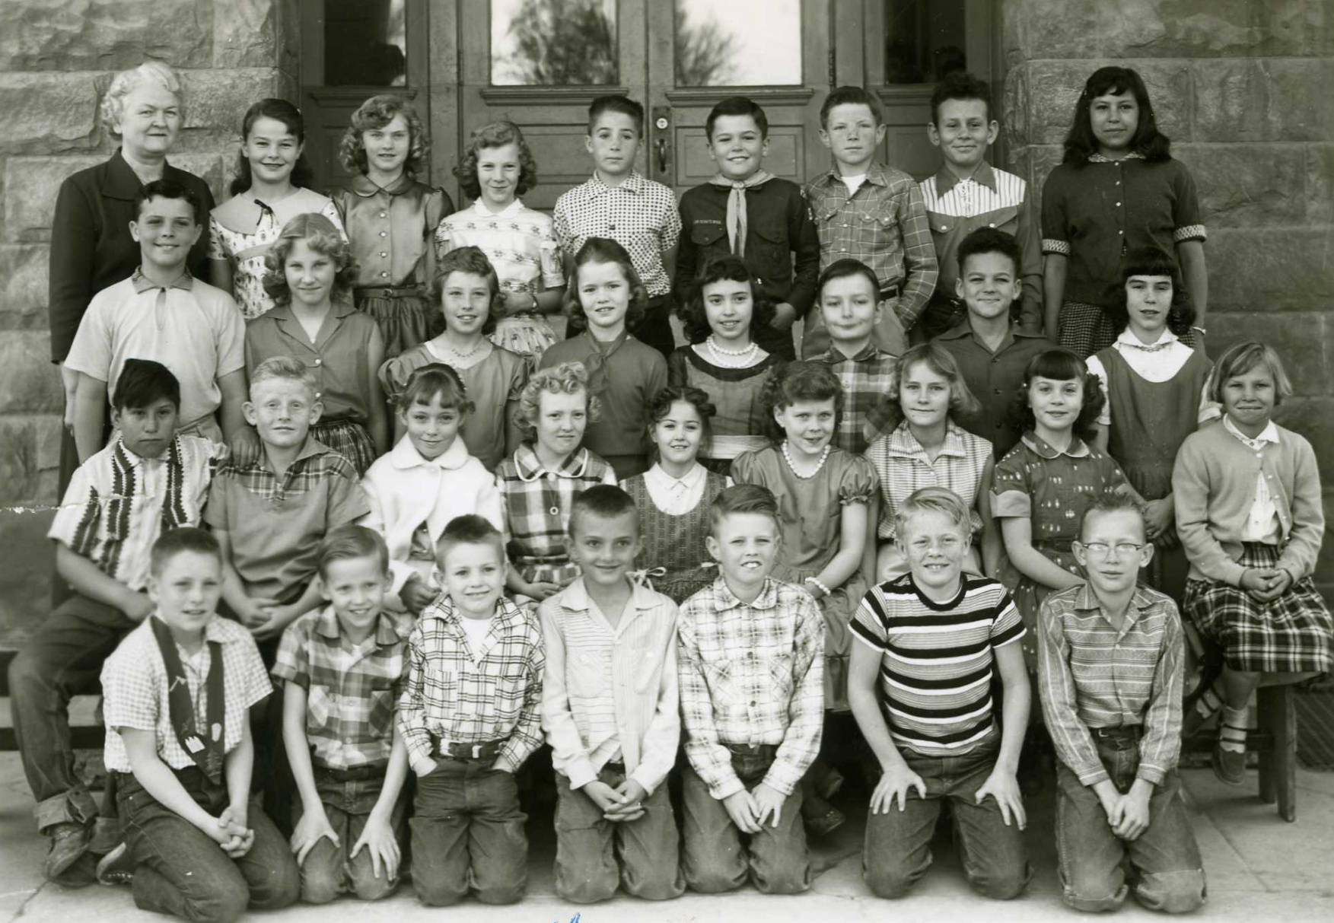
4th Grade – Seline (& 3rd Grade), Benjamin Elementary 1956-57, Benjamin, Utah
Front l to r: Terry Caras , Steven Stewart, Robert Thornton, Larry Thornton, Jay Earl Ludlow, Brent Hawkins
2nd: _(?)__Martinez, Jim Clark, Ruth Bazley, Ann West, Judy Thornton, Colleen Worthen, Jean Brailsford,
Marva Hickman, Maxine Jolley 3rd: Alan Richardson, Sheila Hawkins, Janette Worthen, Vickie Lewis, Colleen Zeeman. Brent Wolfenden, Steven Hansen, Susan Lindsey 4th: Mrs. Edith Seline, Carma Lindstrom, Cheryl Keele,
Maurine Beckstrom , Brent Hickman, Dee Thompson, Ron Dunn, Larry Young, Jean Martinez

Slide 4
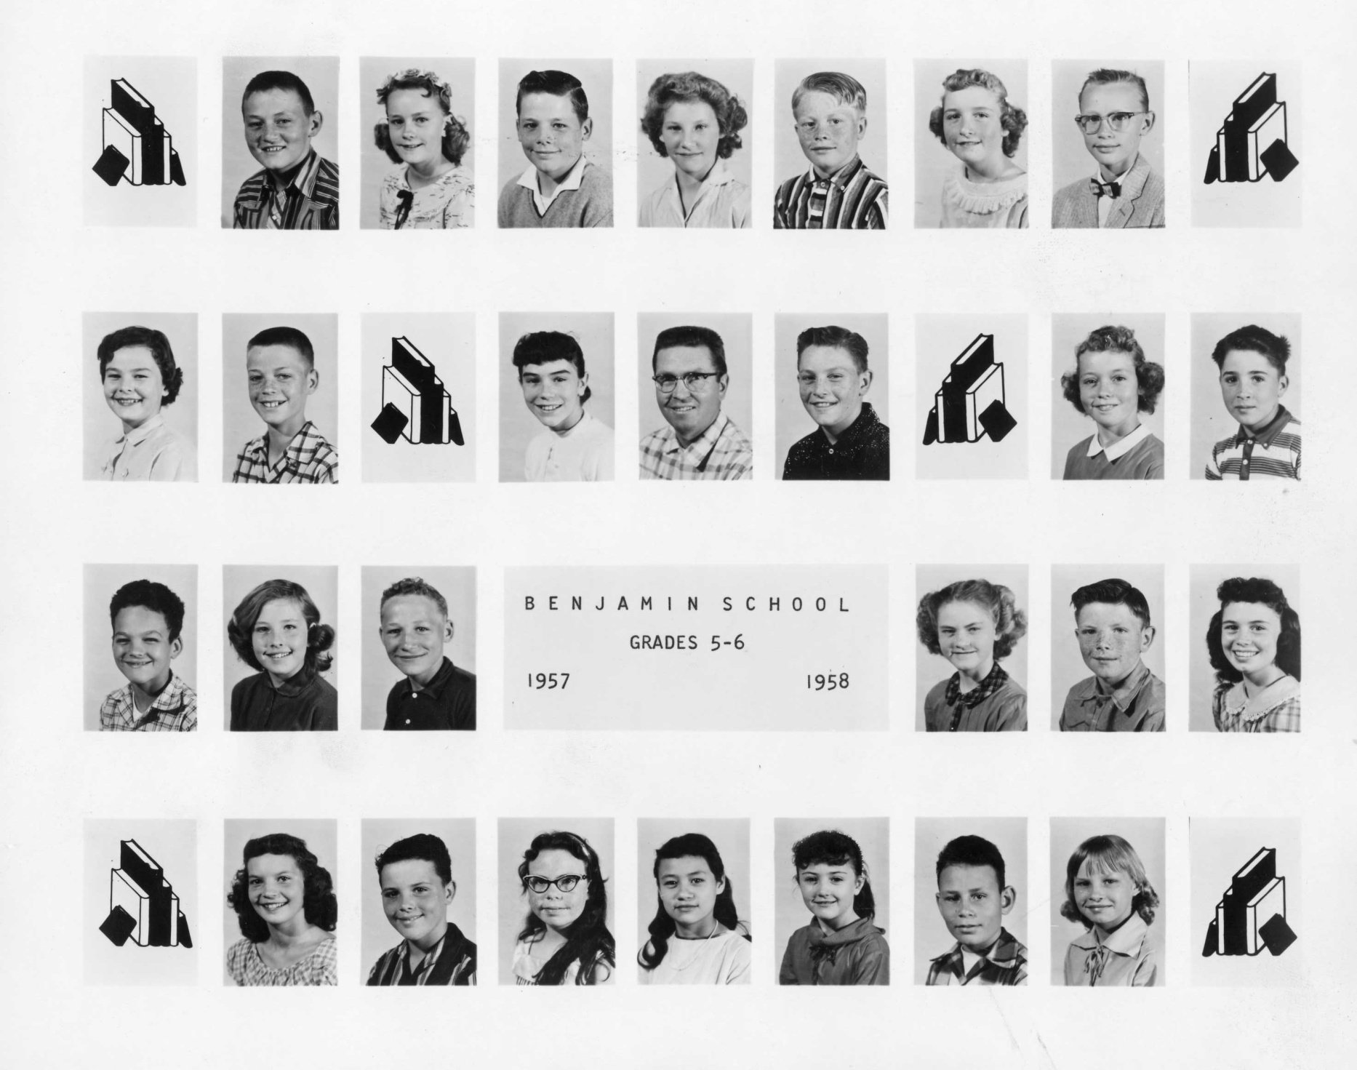
5th Grade - Dunn (& 6th Grade), Benjamin Elementary 1957-58, Benjamin, Utah
Jay Bingham
Jean Brailsford
David Johnson
Sheila Hawkins
Jay Earl Ludlow
Julie Bazley
Brent Hawkins
Carma Lindstrom
Jay
Garlick
Susan
Lindsey
Mr. Dunn
Terry Caras
Ruth
Bazley
Brent
Hickman
Steven Hansen
Janette
Worthen
Max
Jolley
Cheryl
Keele
Ronald Dunn
Junnette
Shepherd
Sharlene
Peay
Alan Richardson
Carol
Payne
Judy
Blanchard
Judy Lynn Thornton
Larry Young
Maxine Jolley

Slide 5
Lake Shore Elementary School
Lake Shore, Utah

Slide 6
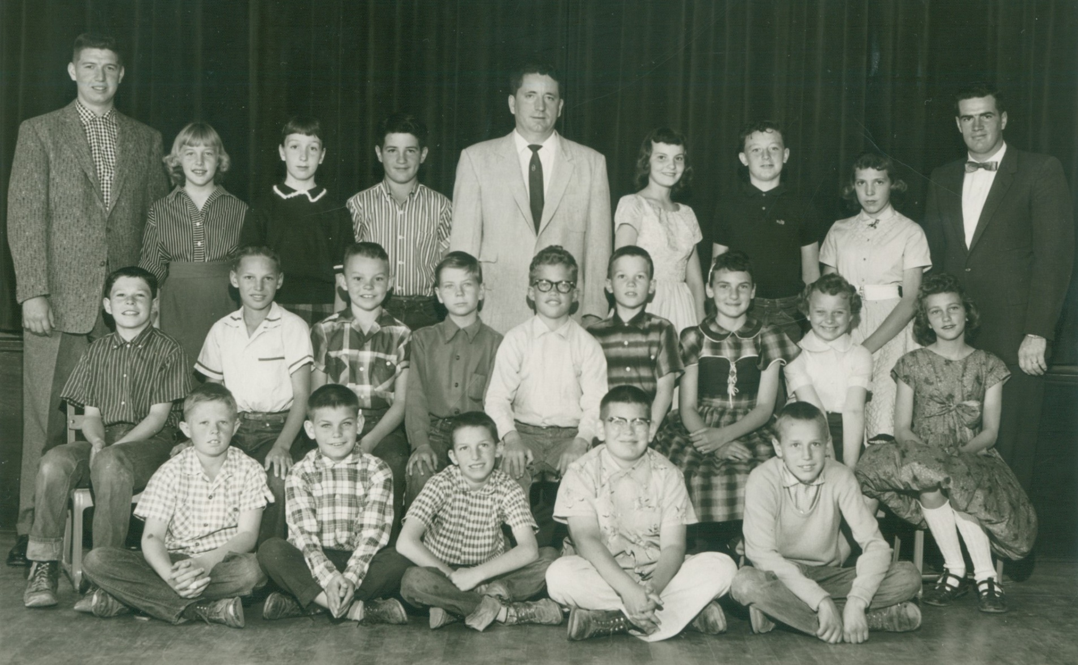
6th Grade – Clark & Argyle (& 5th Grade), Lake Shore Elementary 1957-58, Lake Shore, Utah
Front l to r: Jim Rigtrup , Terry Gordon, Jay Lynn Huff, Carl Schroder, Donald Evans 2ndJay Dean Clayson,
Ronald Sumsion, Allen Christmas, Phillip Sabey, Johnny LeBaron, Earl Huff, Helen Larsen, Susan Beckstrom,
Sandi Anderson 3rd: Mr. Bills, Joyce Beckstrom, Pat Huff, Duke Belders (?Park), Mr. Clark, Janet Anderson, Mike Bellows,
Cheryl Whitely, Mr. Argyle (Teachers: 5th – Mr Bills; 6th – Mr. Clark, Mr Argyle)

Slide 7
Central Elementary School
Spanish Fork, Utah

Slide 8
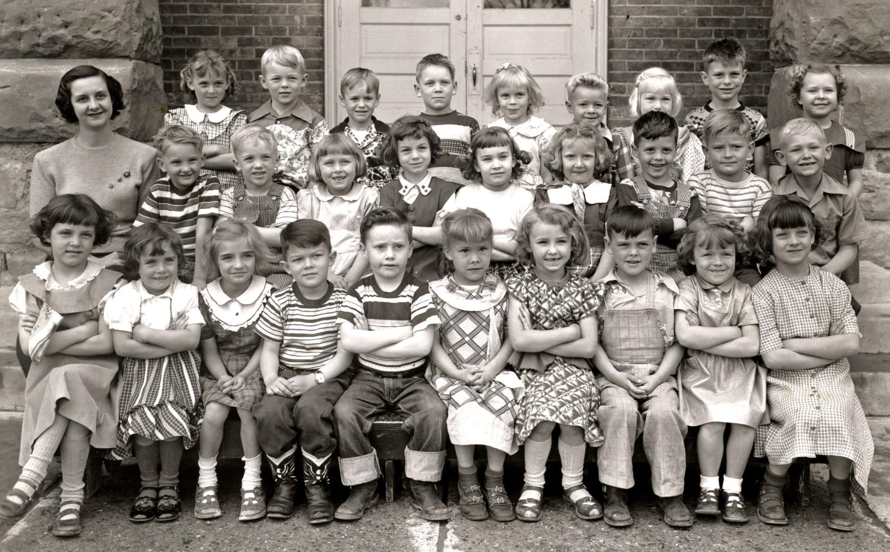
Kindergarten - Sargent, Central Elementary 1952-53, Spanish Fork, Utah
Front l to r: Kay Marie Isaac , ___1/2nd___ , Carolyn Johnson , Reid Nelson, Billy Jacobson, Merilyn Christianson (? , Gaylene Dowley , Steve Nordstrom, Barbara Bellows, Pat Wood 2nd: Mrs. Sargent, Frank Leifson , __2/3rd__ ,
Susan Johnston , Marilyn Twelves, Pat Andrus , Peggy Jean Johnson, Reid Carlson, Kent Money, Tom Beckstrom
3rd: Lois Christensen, __3/2nd___ , Ronnie Ostler, Johnny Strange, , ___3/5th__ , Earnie Walker, Nellie Gay Cope,
Ronnie Cutshall, Evelyn Peterson

Slide 9
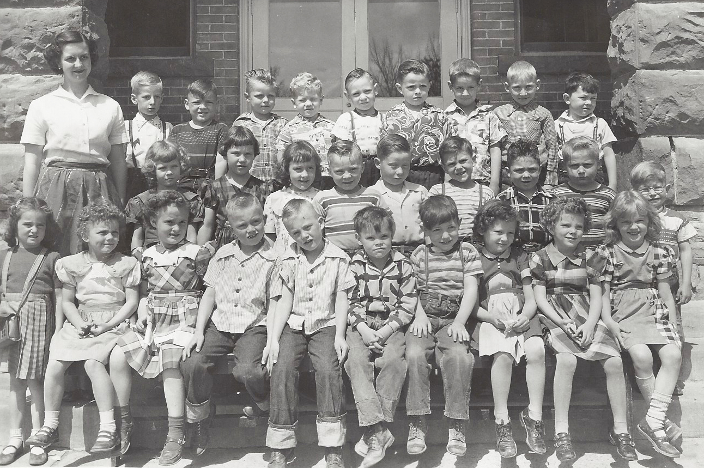
Kindergarten – Sargent (2), Central Elementary 1952-53, Spanish Fork, Utah
Front l to r: Lynda Denison, Shirleen Smith, Burnadine Dallin, Ed Anderson, Ted Anderson, Clark Olsen, James Vincent ,
Karen Prince, Elaine McKell, Marsha Judd 2nd: Karolyn Johnson, Linda Vest, ___2/3___, Allen Peterson, Gary Smith,
___2/6___, Wayne Thorpe, Garth Huff, Allen Geslison 3rd: Mrs. Sargent, ___3/2___, Paul Smith, Steven?___,
Morgan Warner, Mike Pierce, Jim Brinkerhoff, Duke Belters, Joel Volsky, Steve Menlove

Slide 10
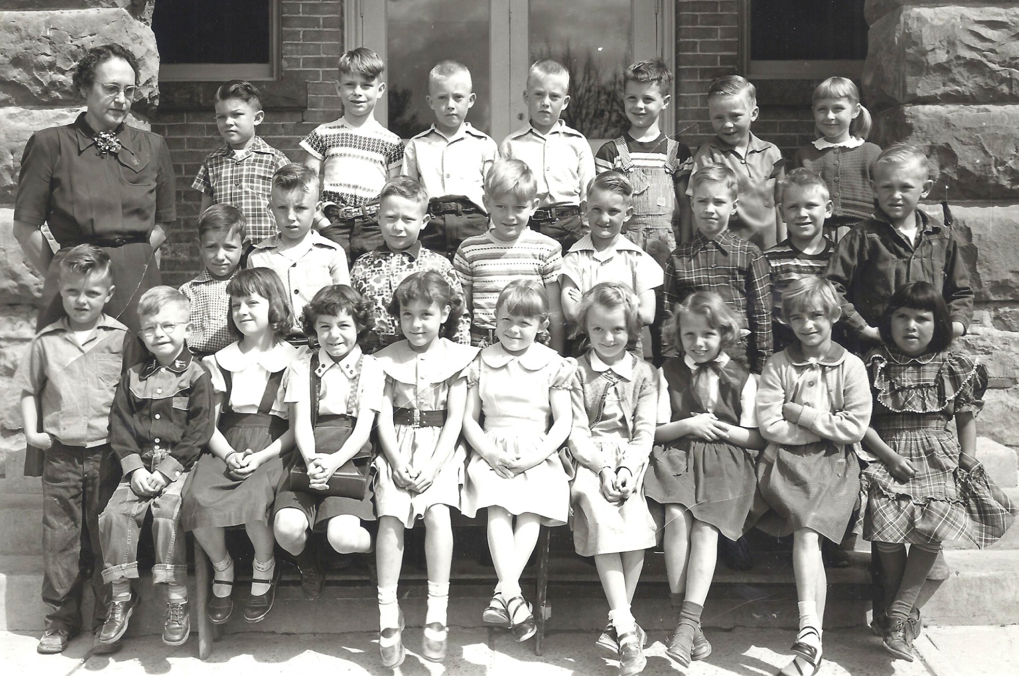
1st Grade - Johnson, Central Elementary 1953-54, Spanish Fork, Utah
Front l to r: Randy, Burnell, Allen Geslison, Patricia Wood, Marilyn Twelves, Barbara Billows, Linda Corbett?, Ida Kay Snell,
Connie Braitwaite, Carolyn Johnson, Virginia Geslison 2nd: James Vincent, Billy,..? ,Gary Smith, Kent Money,
Frank Leifson, John Toronto, Johnny Strange, Tom Beckstrom 3rd Mrs. Vera Johnson, Reid Nelson, Ronnie Cutshall,
Ed Anderson, Ted Anderson, Reid Carlson, Allen Peterson, Susan Johnston

Slide 11
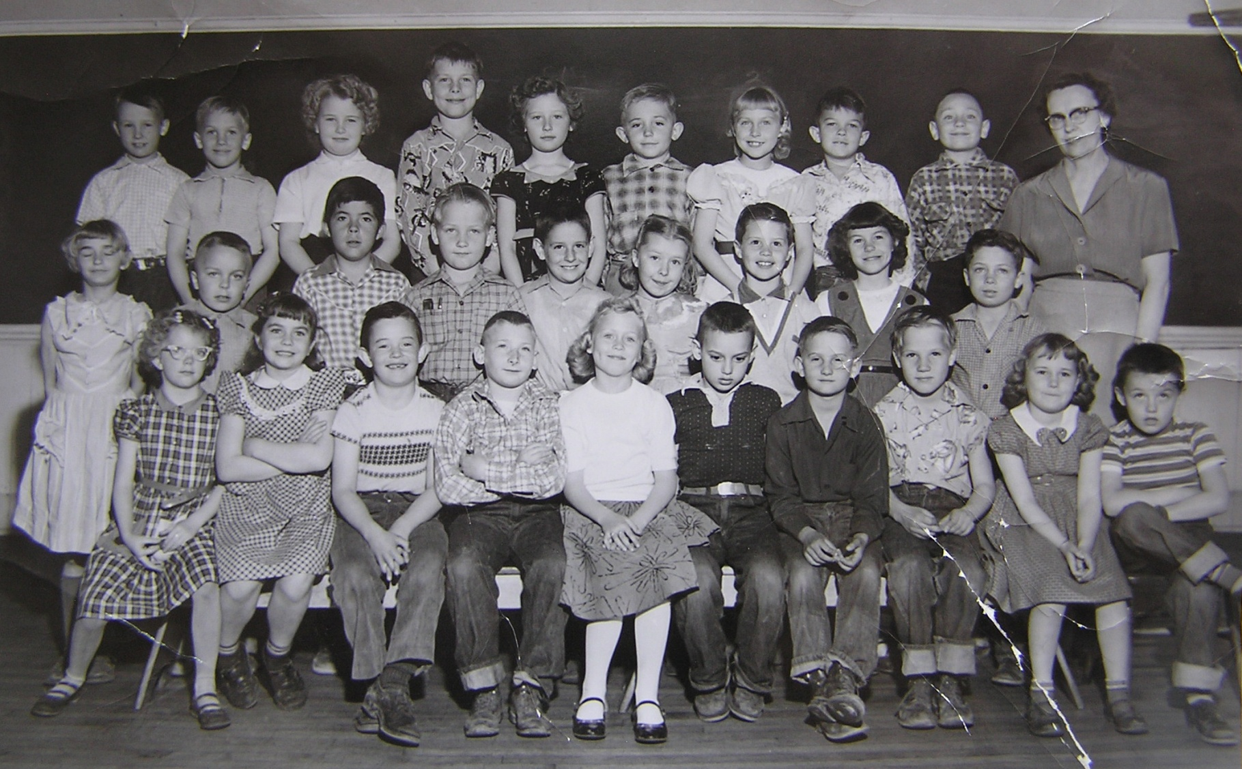
2nd Grade - Nelson, Central Elementary 1954-55, Spanish Fork, Utah
Front l to r: Elaine McKell, ___1/2___ , Milton Moody, Joel Volsky, Judy Darling, Brent Moore, Frank Leifson
Ray Vincent, Joan Ludlow, Steven Isaac 2nd: Carolyn Johnson , Dennis Holly, Tony Gonzalez, Roy Vincent , Duke Belders ,
Evelyn Peterson, Reid Carlson, Marilyn Twelves, Wayne Thorpe 3rd : Duane Koyle , ___3/2nd___ , Bonnie Bills,
Ronny Cutshall, Karen Prince, Steve Johnston, Susan Johnston, Reid Nelson, Mike Pierce, Mrs. Nelson

Slide 12
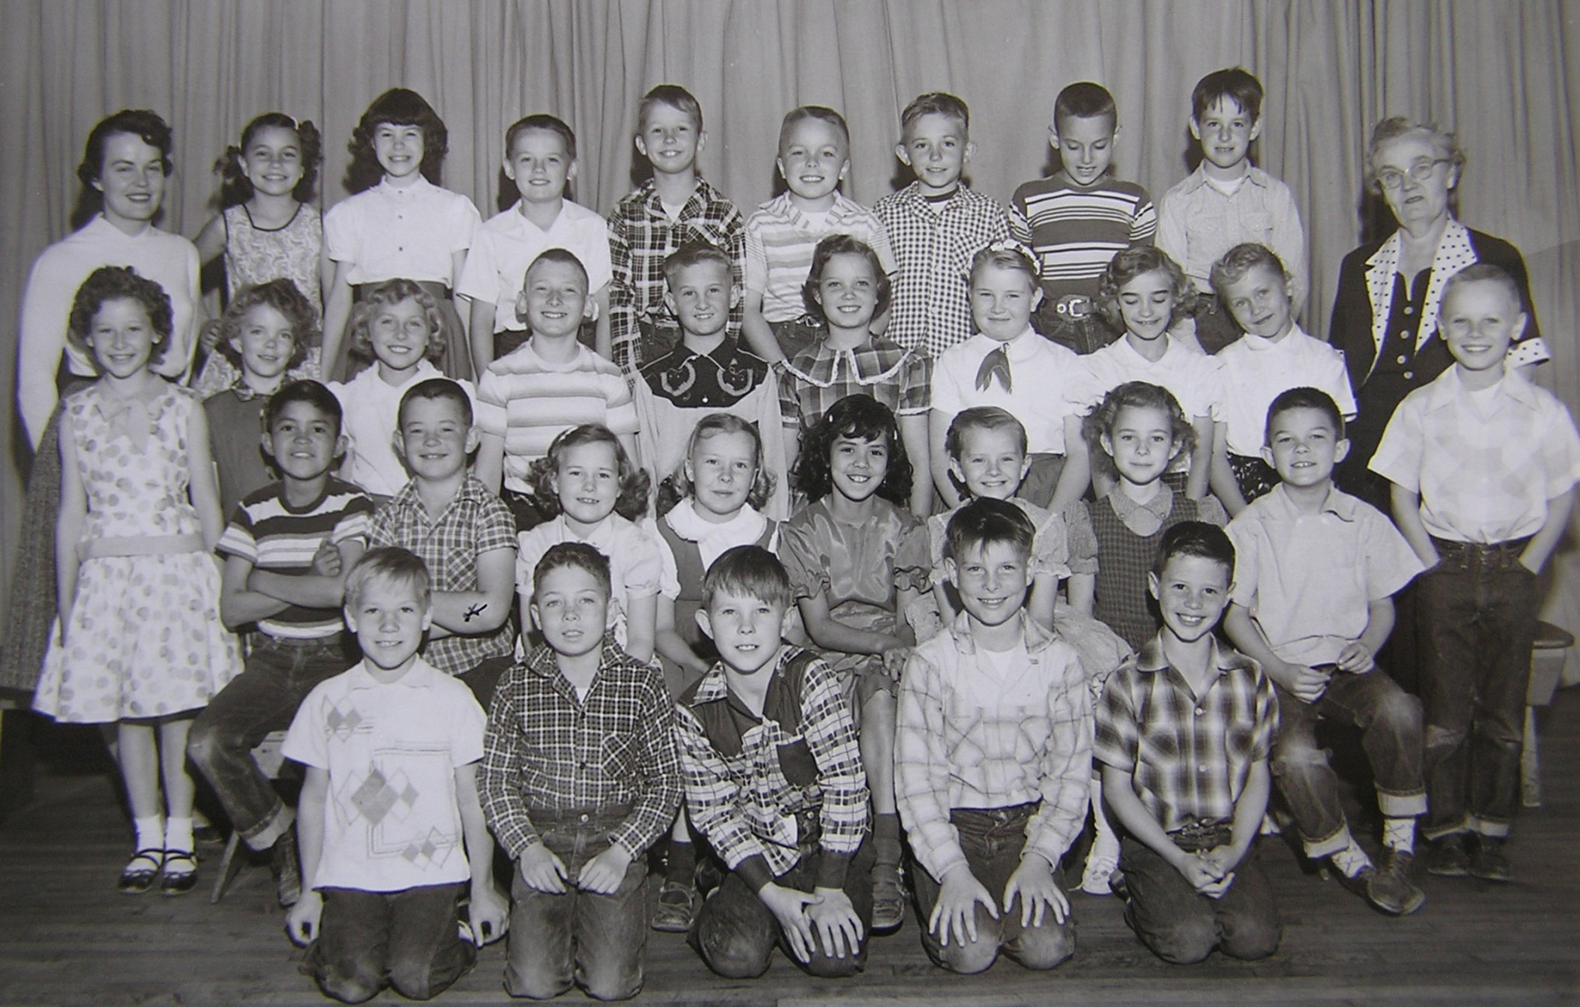
3rd Grade - Stoker, Central Elementary 1955-56, Spanish Fork, Utah
Front l to r: Ray Vincent , Wayne Thorpe, Ronald Parker , Ronny Cutshall, Reid Carlson, 2nd: Tommy Laughing,
Milton Moody, Joan Ludow, Evelyn Peterson, Mary Trujillo, Bonnie Brown, Rhea Warner, Reid Nelson, Bruce Hawkins
3rd : Karen Prince, Elaine McKell, Susan Johnston, Joe Volsky , Frank Leifson, Saundra Carter, Bonnie Bills
Carolyn Johnson, Judy Darling, Mrs. Stoker 4th: Teacher , Connie Knotts, Marilyn Twelves, Steven Isaac, Duane Koyle,
Dennis Holly, Steve Johnston, Brent Moore, Duke Belders

Slide 13
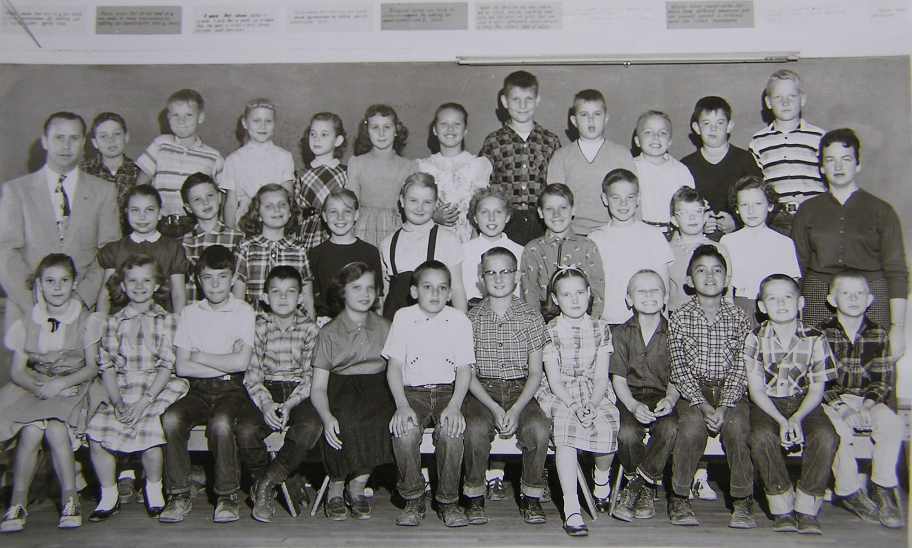
4th Grade - Thomas, Central Elementary 1956-57, Spanish Fork, Utah
Front l to r: Susan Davis (?), Bonnie Brown, David Ellis, Reid Nelson, Saundra Carter, Brent Moore, Frank Leifson,
Joan Ludlow, Bruce Hawkins, Tommy Laughing, Steven Isaac, Ronald Atwood 2nd: Mr. Thomas, Connie Knotts,
Reid Carlson, ___2/4th___ , ___2/5th___ , Bonnie Bills, Susan Johnston, Gary Briggs, Keith Lyman, Elaine McKell,
Karen Prince, ___2/12th___ , 3rd : Wayne Thorpe, Ray Vincent , Judy Darling, Rhea Warner, ___3/5th___ ,
___3/6th___ , Ronny Cutshall, Kelly Crabb, Dennis Holly, Milton Moody, Roy Vincent

Slide 14
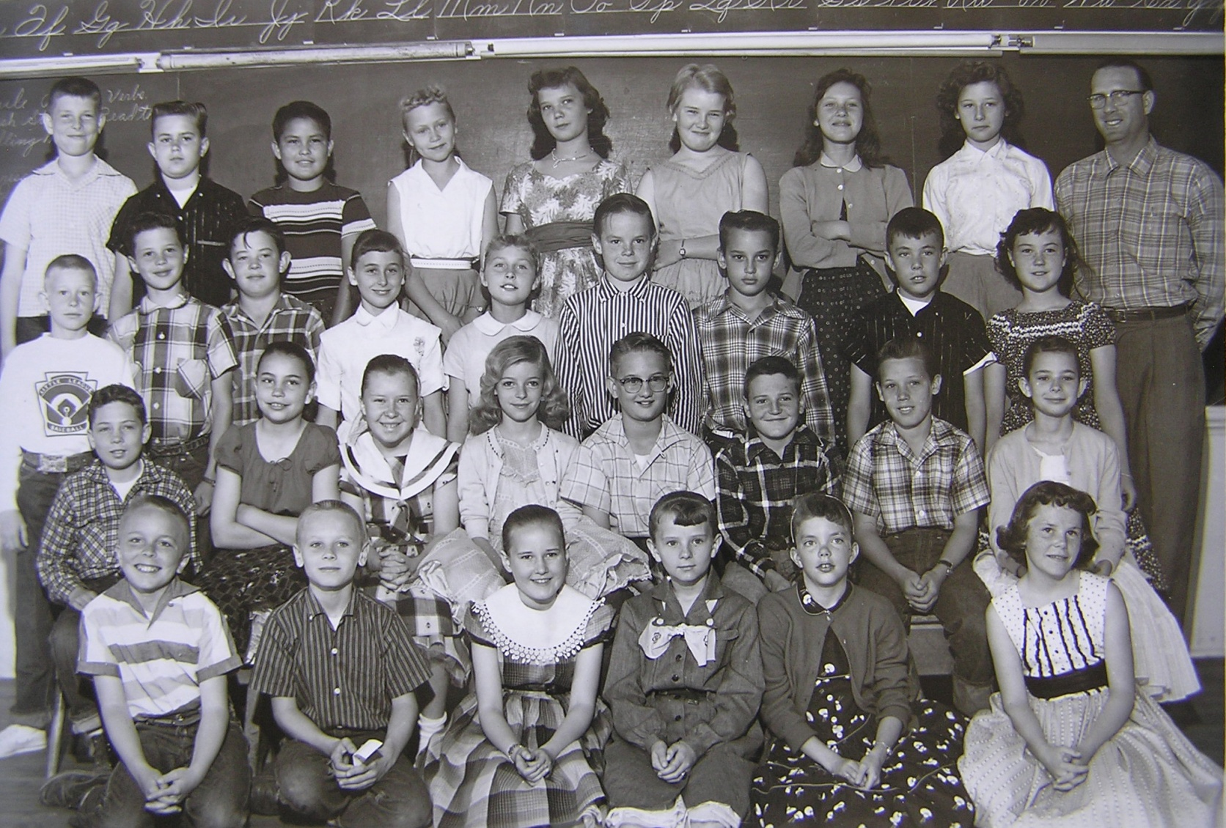
5th Grade - Stewart, Central Elementary 1957-58, Spanish Fork, Utah
Front l to r: Dennis Holley, Bruce Hawkins, Joan Ludlow, Bonnie Brown, Elaine McKell, Deanne Hanson
2nd: Wayne Thorpe, Connie Knotts, Evelyn Peterson, Marilyn Harmonson, Frank Leifson, Gerald Nelson,
Garry Briggs, Rhea Warner 3rd : Ronald Atwood, Reid Carlson, Milton Moody, Susan Davis, Susan Johnston,
Keith Lyman, Brent Moore, David Ellis, Julie Ann Bliss 4th: Ronnie Cutshall, Kelly Crab, Isadore Begay,
Judy Darling, Sandra Carter, Bonnie Bills, Laurel Young, Karen Prince, Mr. Ronald Stewart

Slide 15
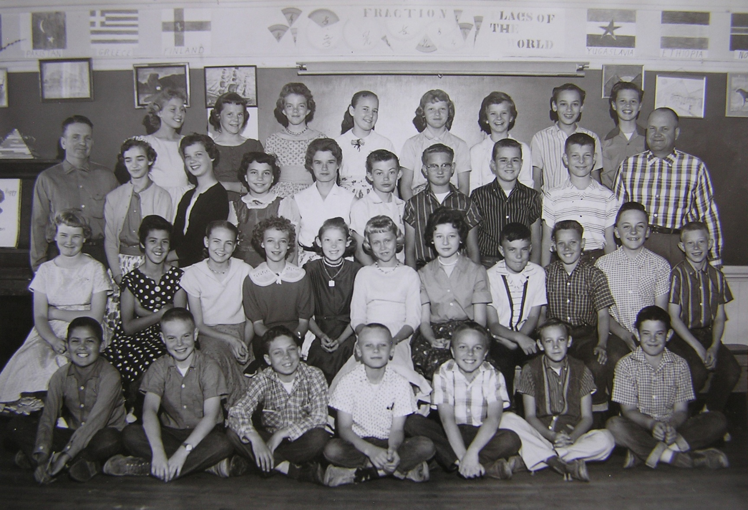
6th Grade – Hill & Grotegut, Central Elementary 1958-59, Spanish Fork, Utah
Front l to r: Isadore Begay, Keith Lyman, Wayne Thorpe, Bruce Hawkins, Dennis Holly, Ron Halverson?, Milton Moody
2nd: Bonnie Bills, Mary Trajillo, Ilene Barney, Marilyn Harmonson, LaRayne Baum, Judy Darling, Karen Prince David Ellis, Gary Briggs, Kerry Maxfield, Ronald Atwood 3rd : Mr. Hill, Carolyn Johnson, Saundra Carter, Connie Knotts,
Judith Morrell, Edward Abbott, Frank Leifson, Kelly Crabb, Ronny Cutshall, Mr. Grotegut 4th: Susan Johnston,
DeAnn Hansen, Elaine McKell, Joan Ludlow, Linda Corbett, Bonnie Brown, Brent Moore, Reid Carlson

Slide 16
Park Elementary School
Spanish Fork, Utah

Slide 17
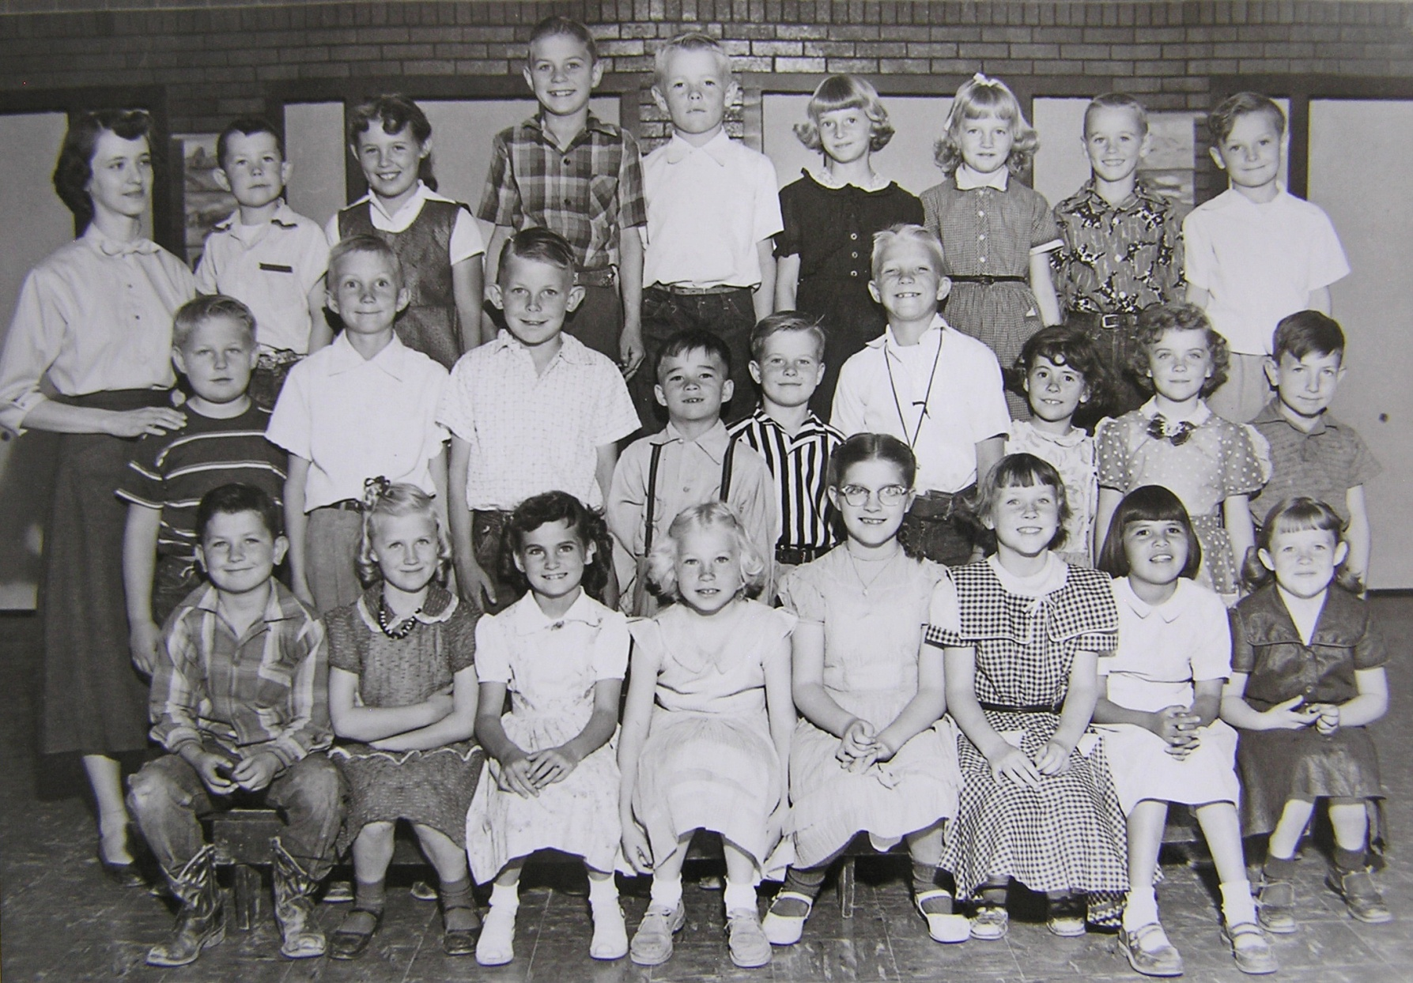
2nd Grade – Moore , Park Elementary 1954-55, Spanish Fork, Utah
Front l to r: Michey Braithwaite, Shanna Rae Shepherd, Lynda Denison, Nellie Gay Cope, Penny Morrell,
Diane Nelson, Virginia Geslison, Barbara Bellows 2nd: Garth Huff, Del Stewart, Walter Scott, Franlkin Rowe,
Douglas Shepherd, Bernell Johnson, Joyce Young, Shirleen Smith, James Vincent 3rd: Mrs. Moore, Steven Menlove,
Judy Jones, Duane Sorenson, Paul ____ , Barbara Ainge, Marsha Judd, Ronnie Ostler, David Nelson

Slide 18
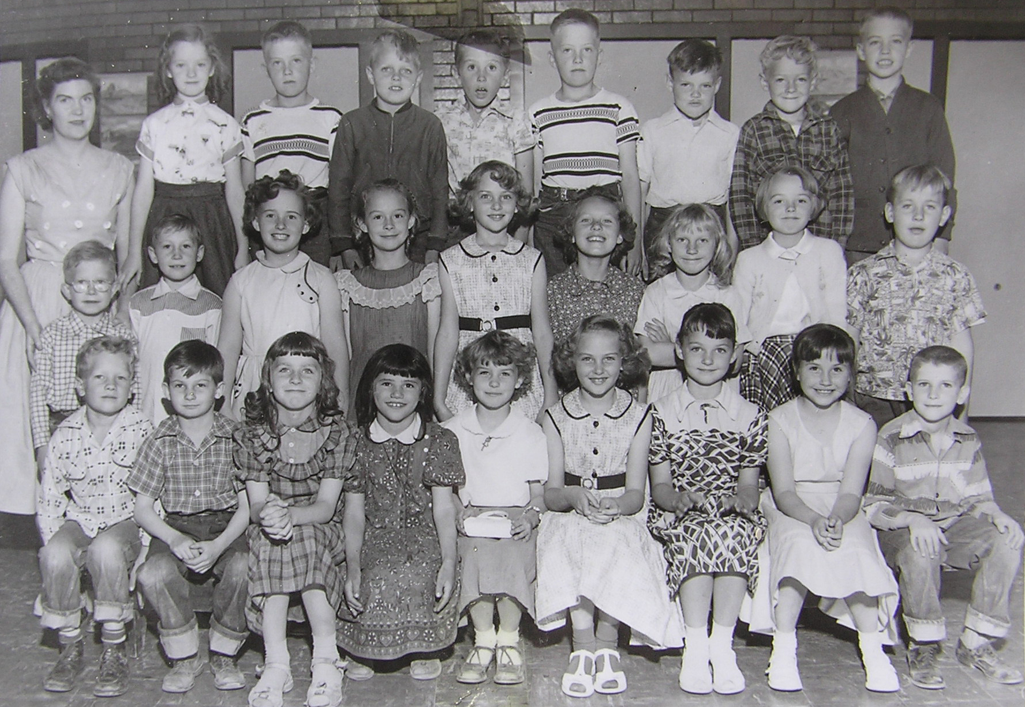
2nd Grade - Criddle , Park Elementary 1954-55, Spanish Fork, Utah
Front l to r: Morgan Warner, Phillip Proctor, Lorna Mecham, Nancy Jenkins, Kathy Hales, Lois Christensen, Marie Clark,
Kristin Losser, ___1/9____ 2nd: Allen Geslison, Larry Evans, Burnadine Dallin, Evelyn Baadsgaard, Lacey Christensen,
Laurel Young?, Barbara Ewell, Ida Kay Snell, Carl Nielson 3rd: Mrs. Carma Criddle, Lorna Byron, Ed Anderson,
Randy Burnell, Warren Johnson, Ted Anderson, Clark Olsen, Earnest Walker, John Toronto

Slide 19
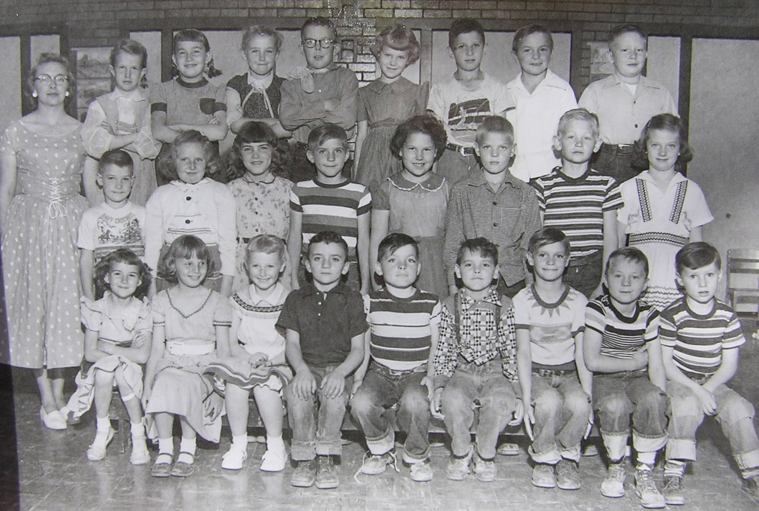
2rd Grade – Ricks , Park Elementary 1954-55, Spanish Fork, Utah
Front l to r: Renee Smith, Connie Braithwaite, Tamara Lasson, David Pace, Paul Smith, Steven Nordstrom,
Martin Peterson, Allen Peterson, ____1/9____ 2nd: ____2/1____, Peggy Jean Johnson, Eileen Jones, Dwight Daniels,
Linda Vest, ____2/6___, Tom Beckstrom, Pat Wood 3rd: Miss Ricks, Renee Ridgley, Patsy Andrus,
Gaylene Dowley, Blaine _____ , Karolyn Johnson, ____3/7____, Blaine Shepherd, Gary Smith

Slide 20
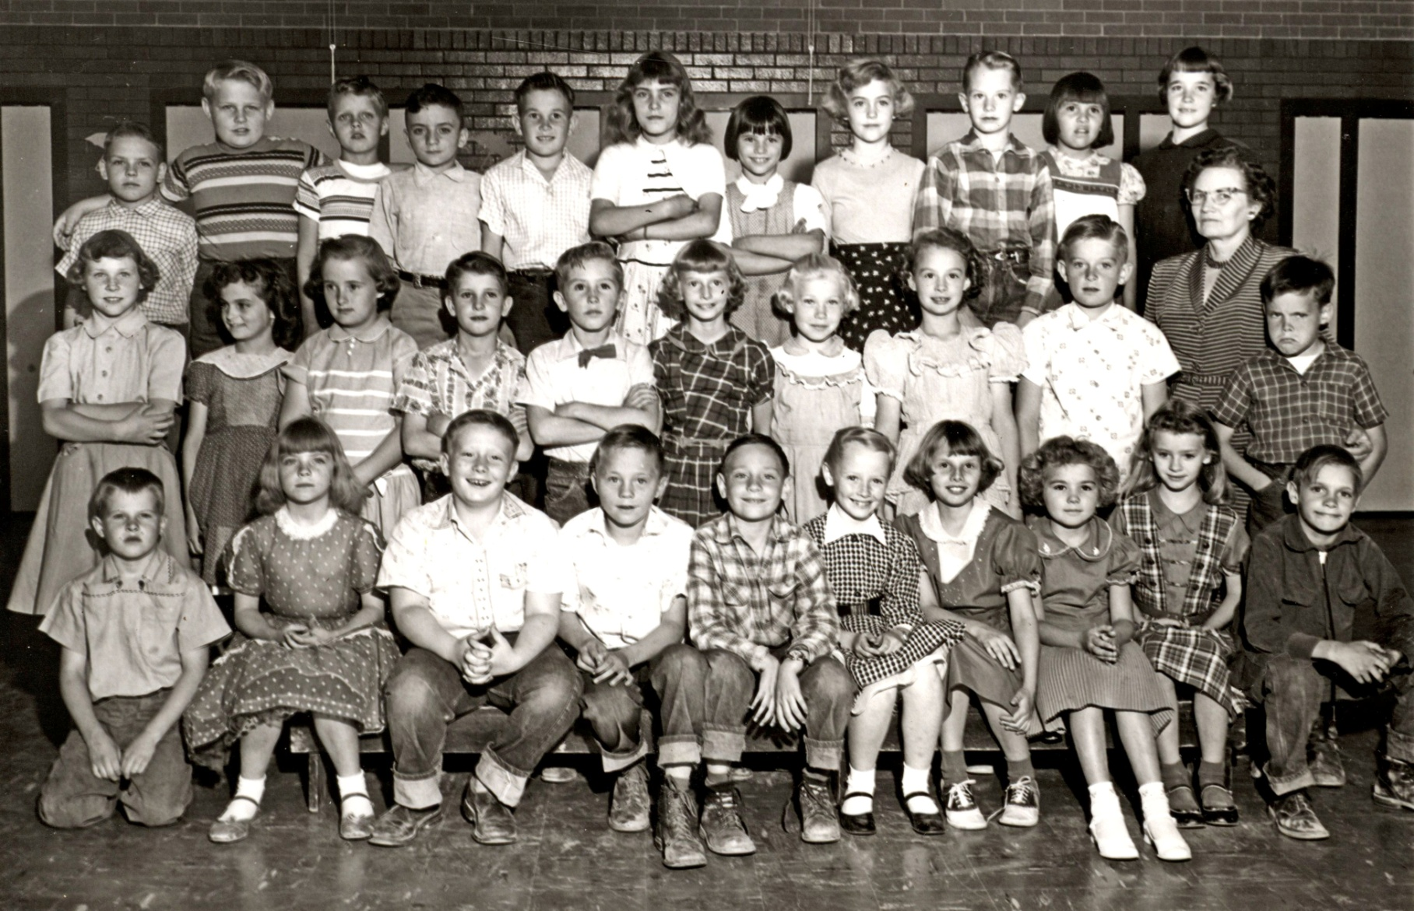
3rd Grade - Price, Park Elementary 1955-56, Spanish Fork, Utah
Front l to r: Doug Shepherd, Shirleen Smith, Gary Smith, Allen Peterson, Michael Pierce, Tamara Lasson,
Connie Braithwaite, Judy Memmott, Marilyn Bauer, Martin Peterson 2nd: Diane Nelson, Lynda Denison,
Burnadene Dallin, Dennis Martin, Warren Johnson, Barbara Ainge, Nellie Gay Cope, Evelyn Baadsgaard, Kent Money,
Mrs. Price, Clark Olsen 3rd: Richard Hartvigsen, Garth Huff, Randy Burnell, David Pace, Glen Memmott, Eileen Jones,
Nancy Jenkins, Susan Amstad, Lee Christensen, Virginia Geslison, Barbara Bray

Slide 21
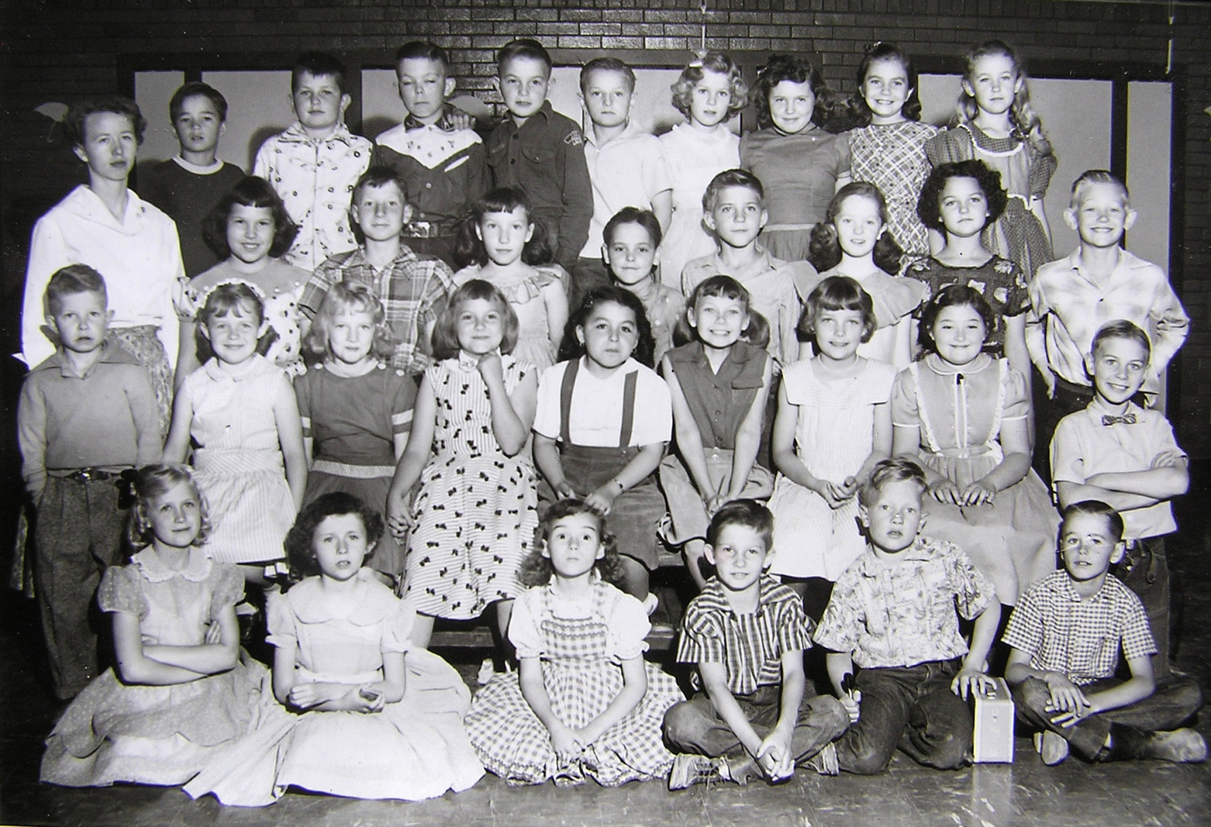
3rd Grade - Smith, Park Elementary 1955-56, Spanish Fork, Utah
Front l to r: Shanna Rae Shepherd, Janice Nielsen, Renee Smith, Phillip Proctor, Morgan Warner, Ronnie Ostler
2nd: Allen Geslison, ___2/2___, Marsha Judd, ___2/4___., ___2/5___, Kathy Claybrook, Jana Lee Russell,
Mary Carol Taylor, Duane Sorenson 3rd: Mss. Smith, Linda Vest, Duane Beardall, Patsy Kay Larson, Steven Nordstrom,
Dwight Daniels, Lorna Byron, Marie Clark, Tom Beckstrom 4th: Frankie Rowe, Mickey Braithwaite, ___4/3___,
Blaine Shepherd, David Nelson, Karolyn Johnson, Judy Jones, ___4/9___, Shirleen Smith

Slide 22
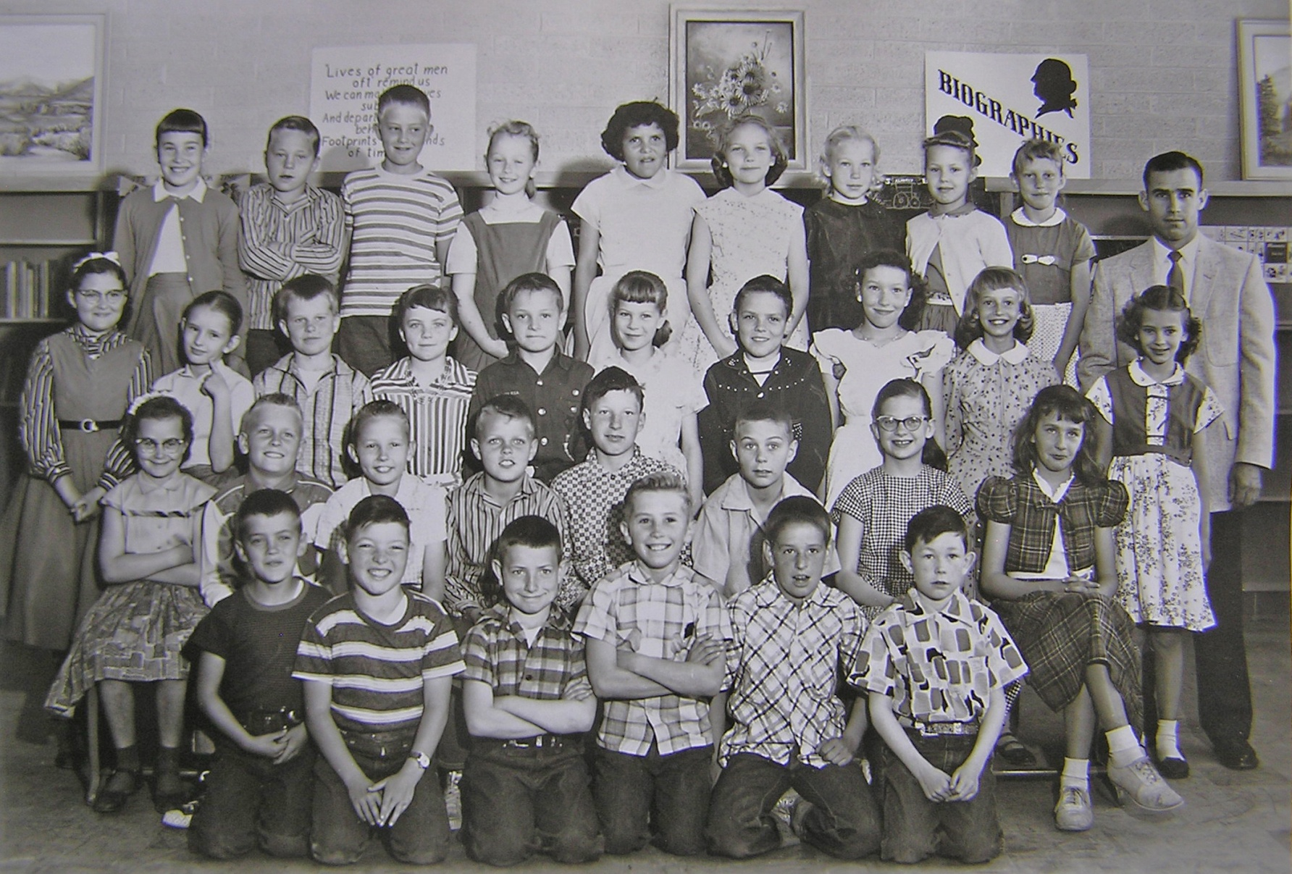
4th Grade - Jones, Park Elementary 1956-57, Spanish Fork, Utah
Front l to r: Delynn B______ , Paul Smith, James Vincent, Warren Johnson, Duke Belders, Steven Menlove
2nd: Dorothy Williams, Danny Allen, Duane Koyle, Randy Bernell, Duane Beardalll, Duane Sorenson, Pat Wood,
Lorna Mecham 3rd: Mary Carol Taylor, Cathy Stephens, Douglas Shepherd, Shirlene Smith, David Nelson, Karolyn
Johnson, Richard Hull, Pat Larson, Barbara Ainge, Marilyn Bauer 4th: Pat Andrus, Allen Peterson, Teddie Anderson,
Tamara Lasson, Virginia Geslison, Jana Lee Russell, Nellie Gay Cope, Marilyn Christenson, Barbara Ewell, Mr. Jones

Slide 23
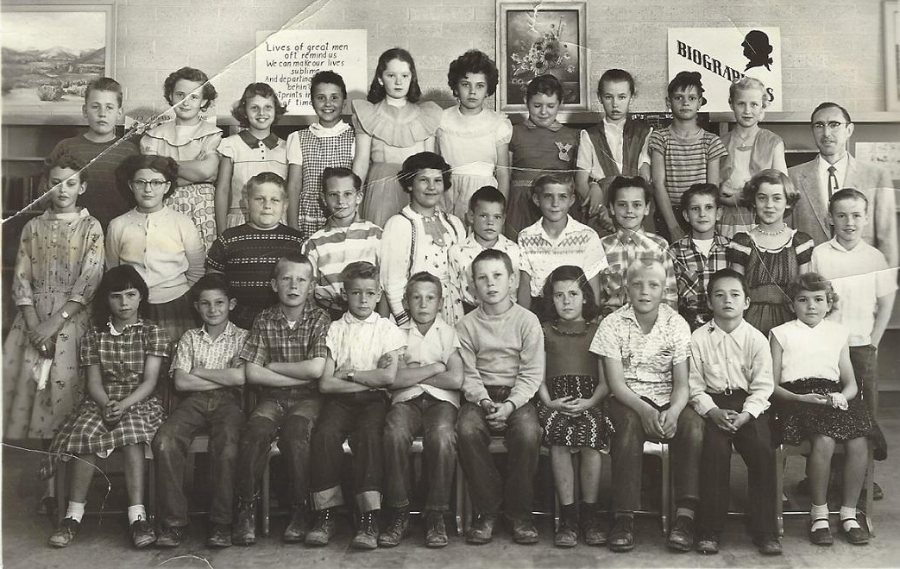
4th Grade - Young, Park Elementary 1956-57, Spanish Fork, Utah
Front l to r: Nancy Jenkins, Phillip Proctor, Merrill Diamond, Ernest Walker, Larry Evans, Ronald Parker, Joyce Young
Burnell Johnson, Frankie Rowe, Judi Memmott 2nd: Lois or Lacey Christenson, Penny Morrell, Garth Huff, Lee Christensen,
Linda Vest, Clark Olsen, Dwight Daniels, Stephen Nordstrom, Dennis Martin, Susan Amstad, Sterling Spencer,
3rd: Carl Nielson, Burnadene Dallin, Connie Braithwaite, Kristin Losser, Lorna Byron, (K?)Cathy Woods, Judy Jones,
Gaylene Dowley, Martin Peterson, Shanna Rae Shepherd, Mr. Young

Slide 24
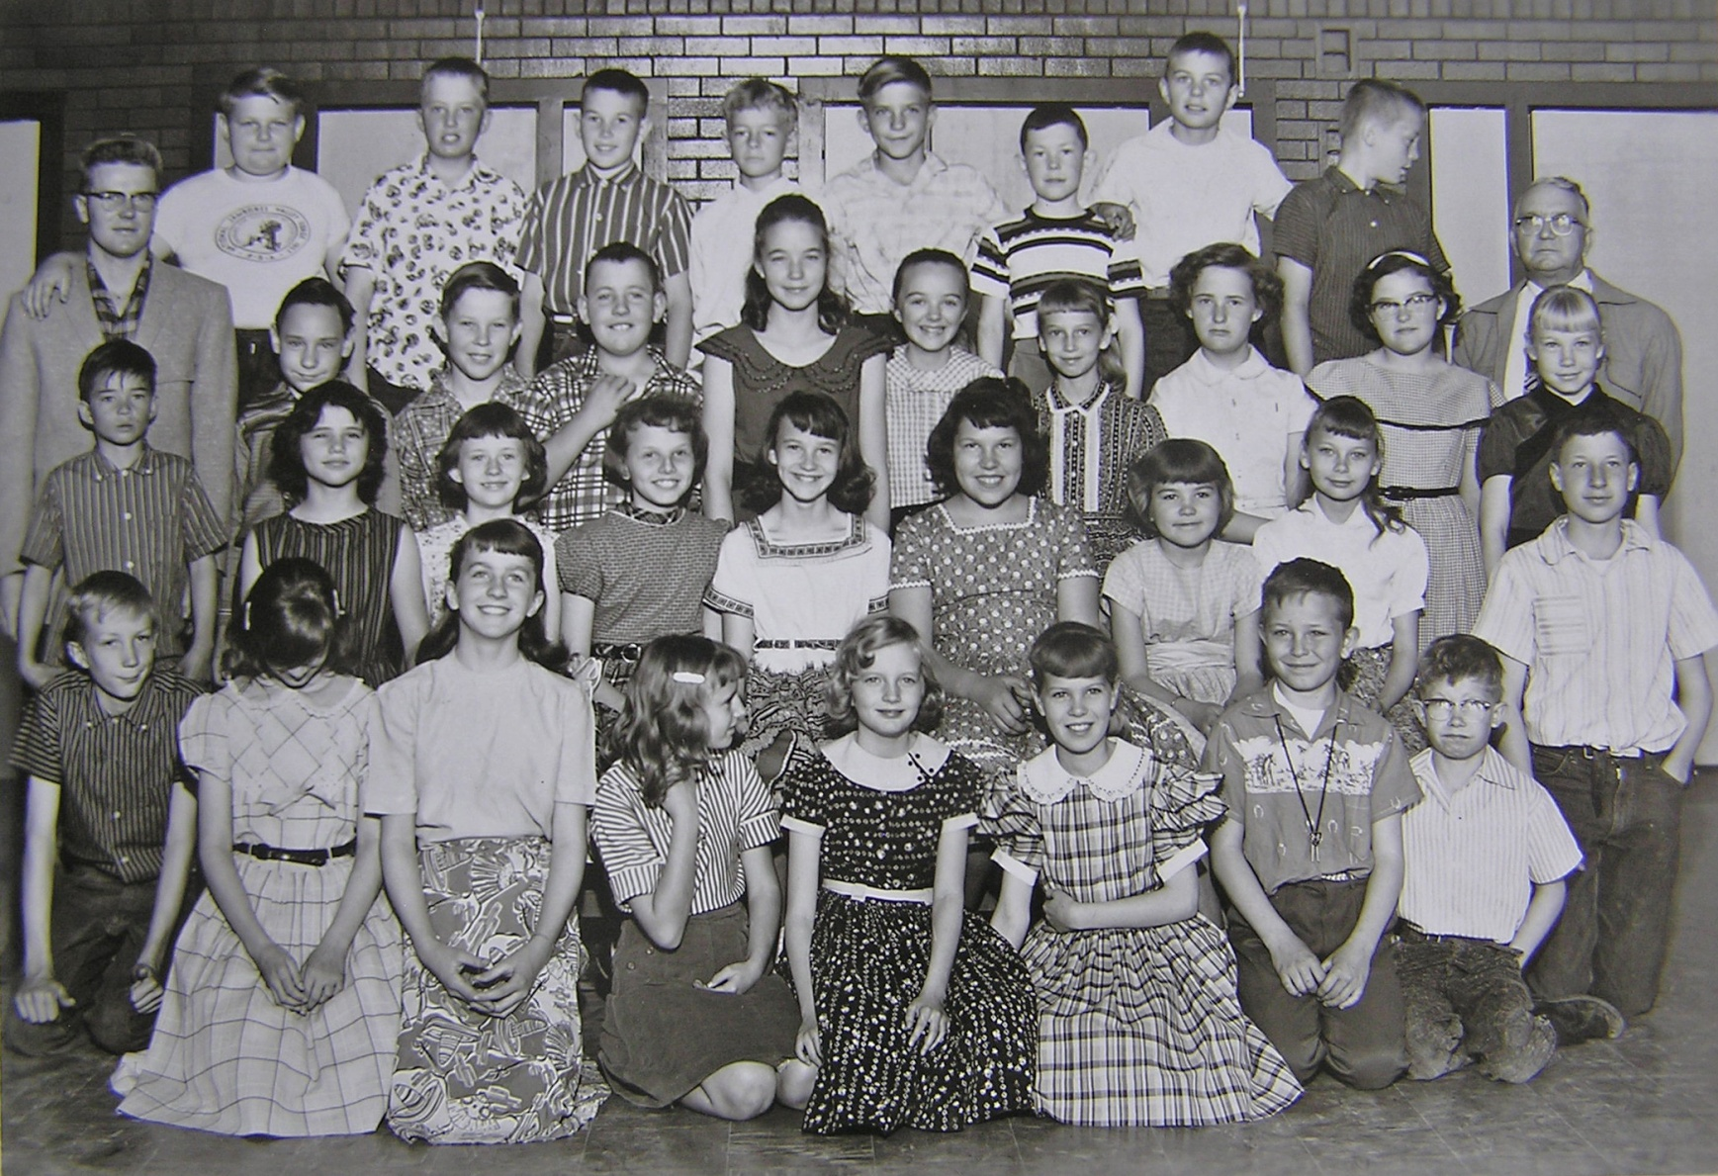
5th Grade - Johnson, Park Elementary 1957-58, Spanish Fork, Utah
Front l to r, Del Stewart, Carolyn Johnson , Lorna Mecham, Cathy Stephens , Marsha Judd, Karolyn Johnson, Billy Fitch,
Allen Geslison 2nd: Franklin Rowe, Nancy Jenkins, Janice Nielson, Connie Joy Braithwaite, Patricia Swenson,
Linda Kay Vest, Judy Memmott, Kathy Claybrook, Duane Beardall 3rd: Mr. Paul Curtis , Michael Pierce. Ronald Parker,
Carl Nielson, Barbara Bray, Ida Kay Snell, Barbara Ainge, Burnadene Dallin, Mary Carol Taylor, Nellie Gay Cope
4th: Garth Huff, Edward Anderson, Glen Memmott, Ernest Walker, Dwight Daniels, Steven Menlove, Duane Sorenson,
Allen Peterson, Mr. Wilford T. Johnson

Slide 25
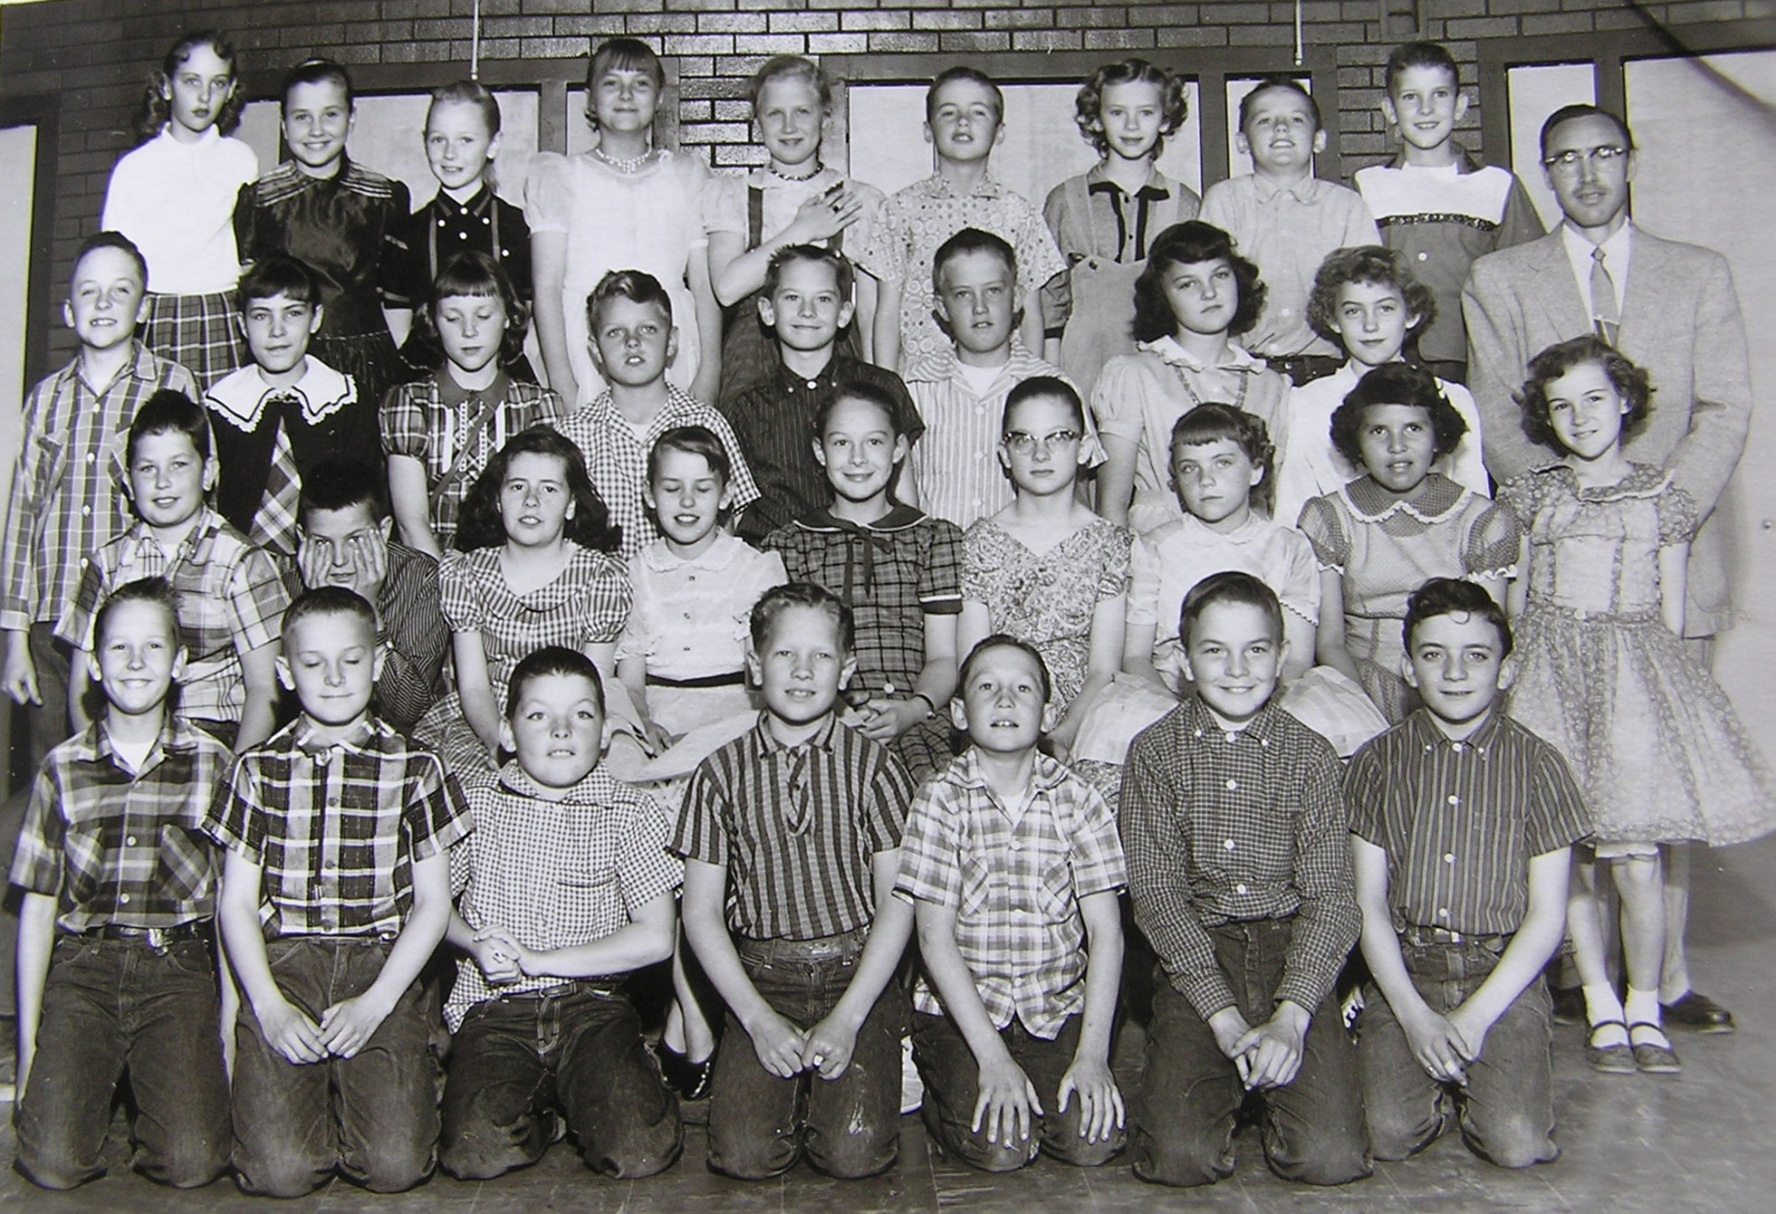
5th Grade - Young , Park Elementary 1957-58, Spanish Fork, Utah
Front l to r, Duane Koyle, David Nelson, Paul Smith, Morgan Warner, Larry Evans, Blaine Shepherd, David Pace
2nd: Michael Braithwaite, Breton Blackett, Joyce Young, Kathreen Hales, Evelyn Baadsgaard, Patricia Wood, Shirleen Smith
Virginia Geslison, Renee’ Smith 3rd: Kerry Maxfield, Eileen Jones, Diane Nielsen, Randy Burnell, Lee Christensen,
Ted Anderson, Marie Clark, Susan Amstad. Mr. Young 4th: Lacey Christensen, Kristin Losser, Tamara Lassen, Kathleen Hill,
Shauna Rae Shepherd, Sterling Spencer, Marilyn Bauer, Stephen Isaac, Dennis Martin Absent: Clark Olsen, Paul Thompson

Slide 26
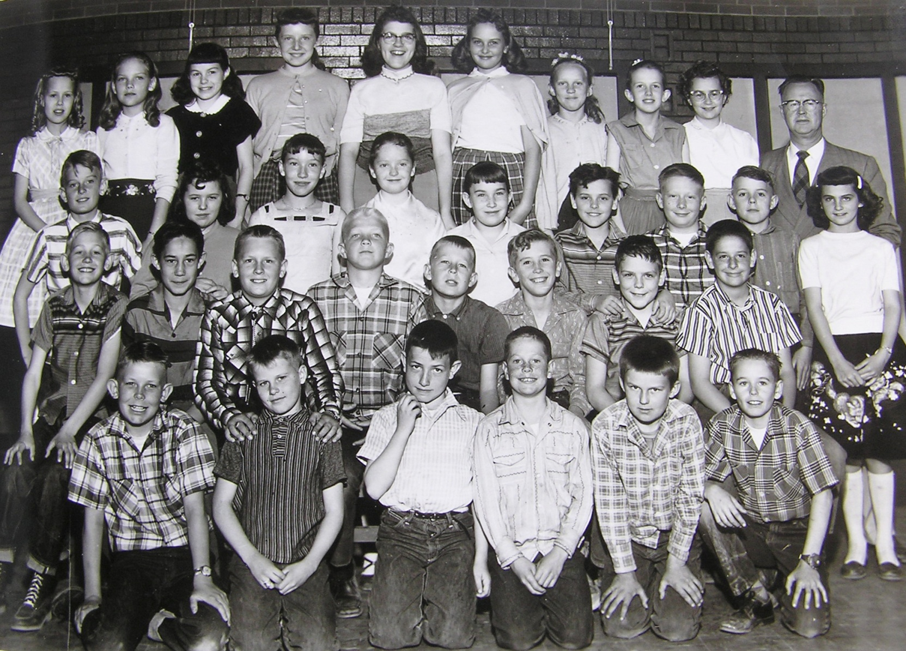
5th Grade - Halladay, Park Elementary 1957-58, Spanish Fork, Utah
Front l to r, Walter Scott, Douglas Shepherd, James Vincent, Alan Fullmer, Ronald Hatfield, Ronald Ostler
2nd: Tom Beckstrom, Virgil Neves, Danny Allen, Bernell Johnson, Merrill Diamond, Warren Johnson,
Richard Hartvigson, Duke Belders 3rd: Kent Money, Judy Jones, Patsy K. Larsen, Lorna Byron, Patsy Andrus,
Stephen Nordstrom, Gary Smith, Richard Huff, Lynda Denison 4th: Marilyn Christensen, Jana Lee Russell,
Marilyn Twelves, Peggy Johnson, Penney Morrell, Lois Christensen, Barbara Ewell, Renee Ridgley,
Dorothy Williams, Mr. Meeks Halladay Absent: John Toronto, Kathryn Woods, Martin Peterson

Slide 27
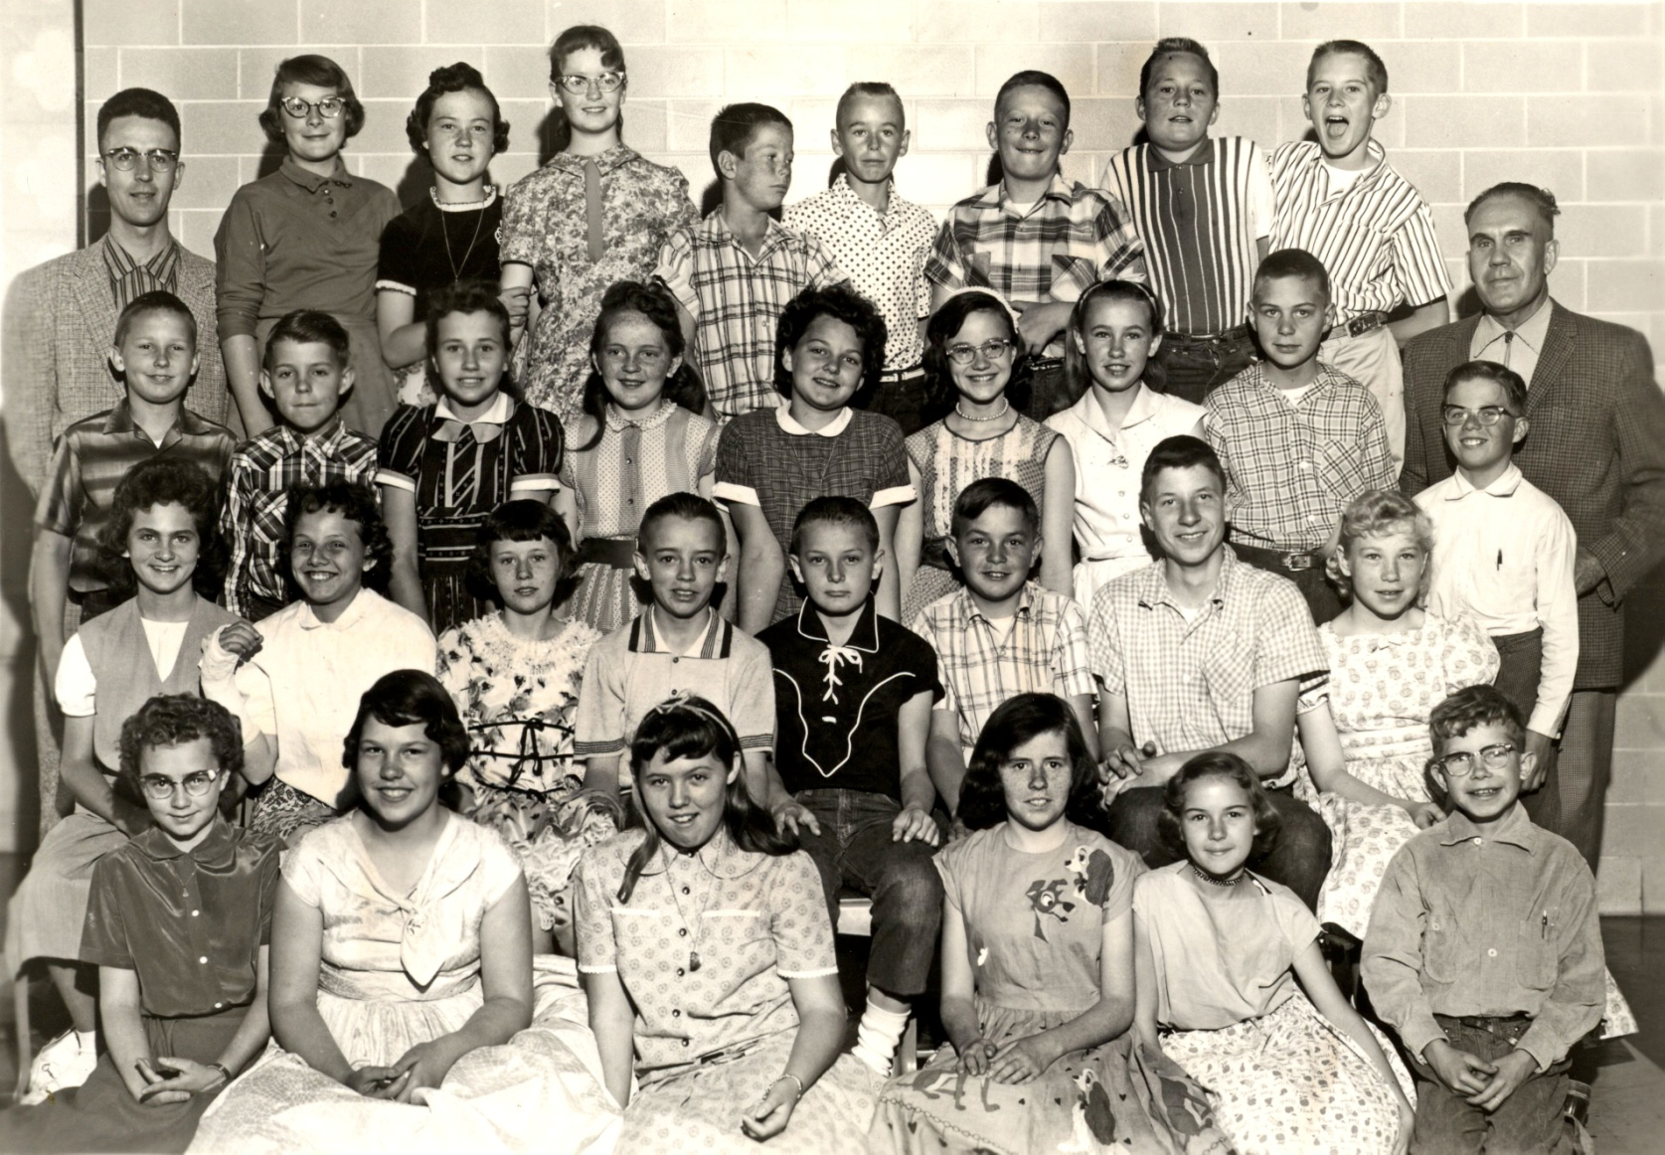
6th Grade - Monk, Park Elementary 1958-59, Spanish Fork, Utah
Front l to r: Dorothy Williams, Linda Vest, Judy Jones, Joyce Young, Renee Smith, Allen Geslison
2nd: Lynda Denison, Connie Braithwaite, Janice Nielson, Paul Furner, David Nelson, Blaine Shepherd,
Duane Beardall, Nellie Gay Cope, Bill Nicholes 3rd: Duane Koyle, Richard Huff, Kristin Losser, Louise Monk,
Marie Clark, Patty Swenson, Gaylene Dowley, Duane Sorenson, Mr. Monk 4th: Mr. Ashby, Evelyn Baadsgaard,
Julie Bliss, Lorna Byron, Alan Fullmer, Ronnie Ostler, Gary Smith, Allen Peterson, Lee Christensen

Slide 28
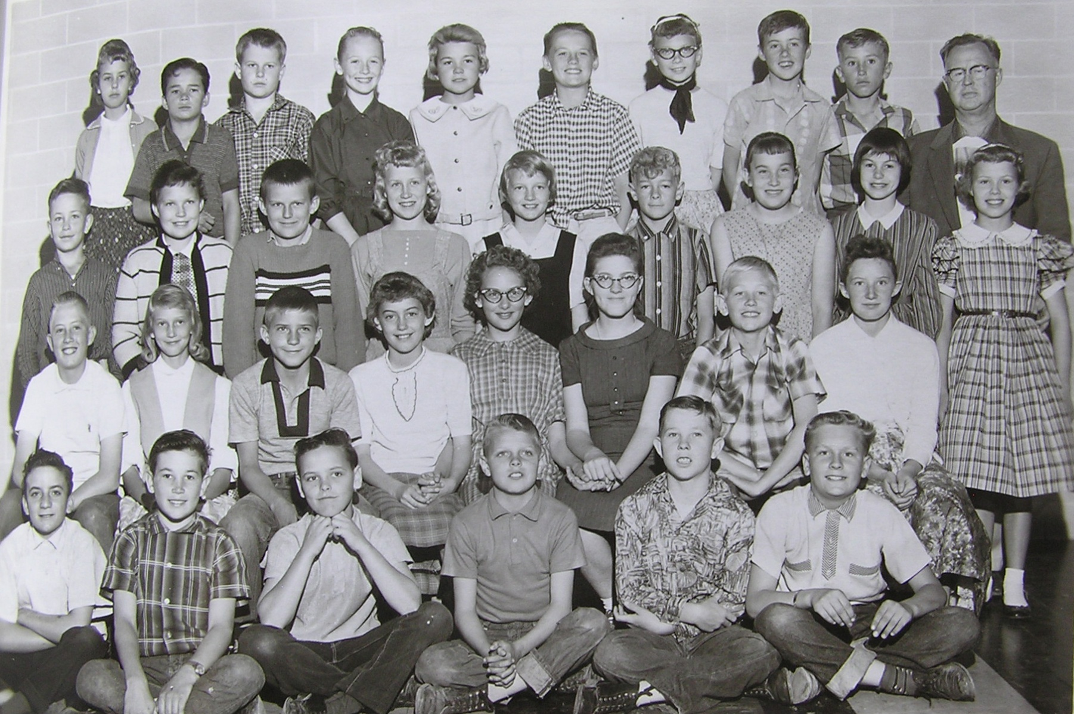
6th Grade - Halladay, Park Elementary 1958-59, Spanish Fork, Utah
Front l to r: David Pace, Glen Memmott, Steve Nordstrom, Randy Burnell, Ronald Parker, Danny Allan
2nd: Ted Anderson, Barbara Ainge, Dwight Daniels, Susan Amstad, Lois Christensen, Penny Morrell, Tom Beckstrom,
Peggy Johnson 3rd: Billy Fitch, Danna Lee Dixon, Ronald Hatfield, Shana Rae Shepherd, Marsha Judd, Ernest Walker,
Pat Andrus, Marilyn Twelves, Marilyn Christensen 4th: Kathy Hales, Franklin Rowe, Douglas Shepherd, Tamara Lasson,
Judy Memmott , Stephen Isaac, Cathy Claybrook, Sterling Spencer, Warren Johnson, Mr. W. Meeks Halladay

Slide 29
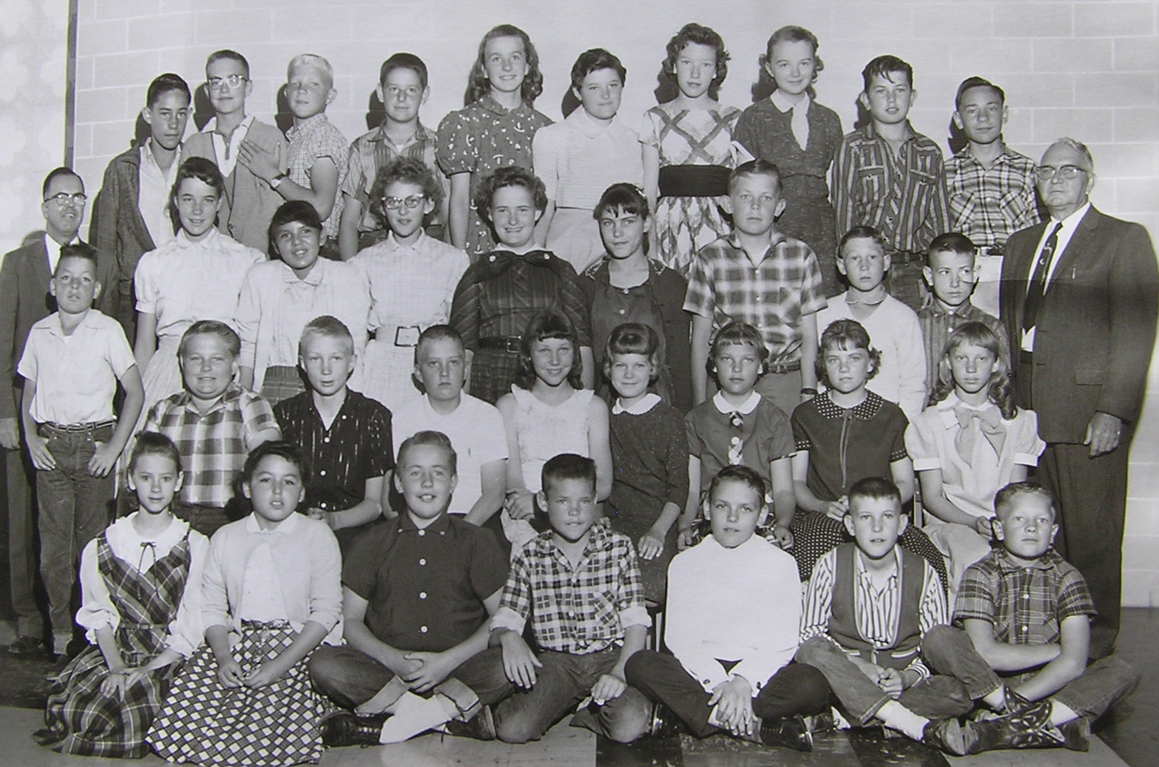
6th Grade - Johnson, Park Elementary 1958-59, Spanish Fork, Utah
Front l to r: Marilyn Bauer, Virginia Martinez, Carl Nielsen, Clark Olsen, Richard Hartvigson, Dennis Martin,
Morgan Warner 2nd: Garth Huff, Dell Stewart, Edward Anderson, Diane Nielsen, Carolyn Johnson, Jana Lee Russell,
Shirlene Smith, Barbara Ewell 3rd: Robert A. Nelson - Principal, Paul Smith, Barbara Bray, Virginia Geslison,
Lacey Christensen, Burnadine Dallin, Eileen Jones, Walter Scott, Larry Evans, James Vincent, Mr. Wilford T. Johnson
4th: Virgil Neves, John Toronto, Bernell Johnson, Duke Belders, Lorna Marie Mecham, Mary Carol Taylor,
Patsy Kay Larson, Ida Kay Snell, Michael Braithwaite, Michael Pierce Absent: Kathryn Woods

Slide 30
Rees Elementary School
Spanish Fork, Utah

Slide 31
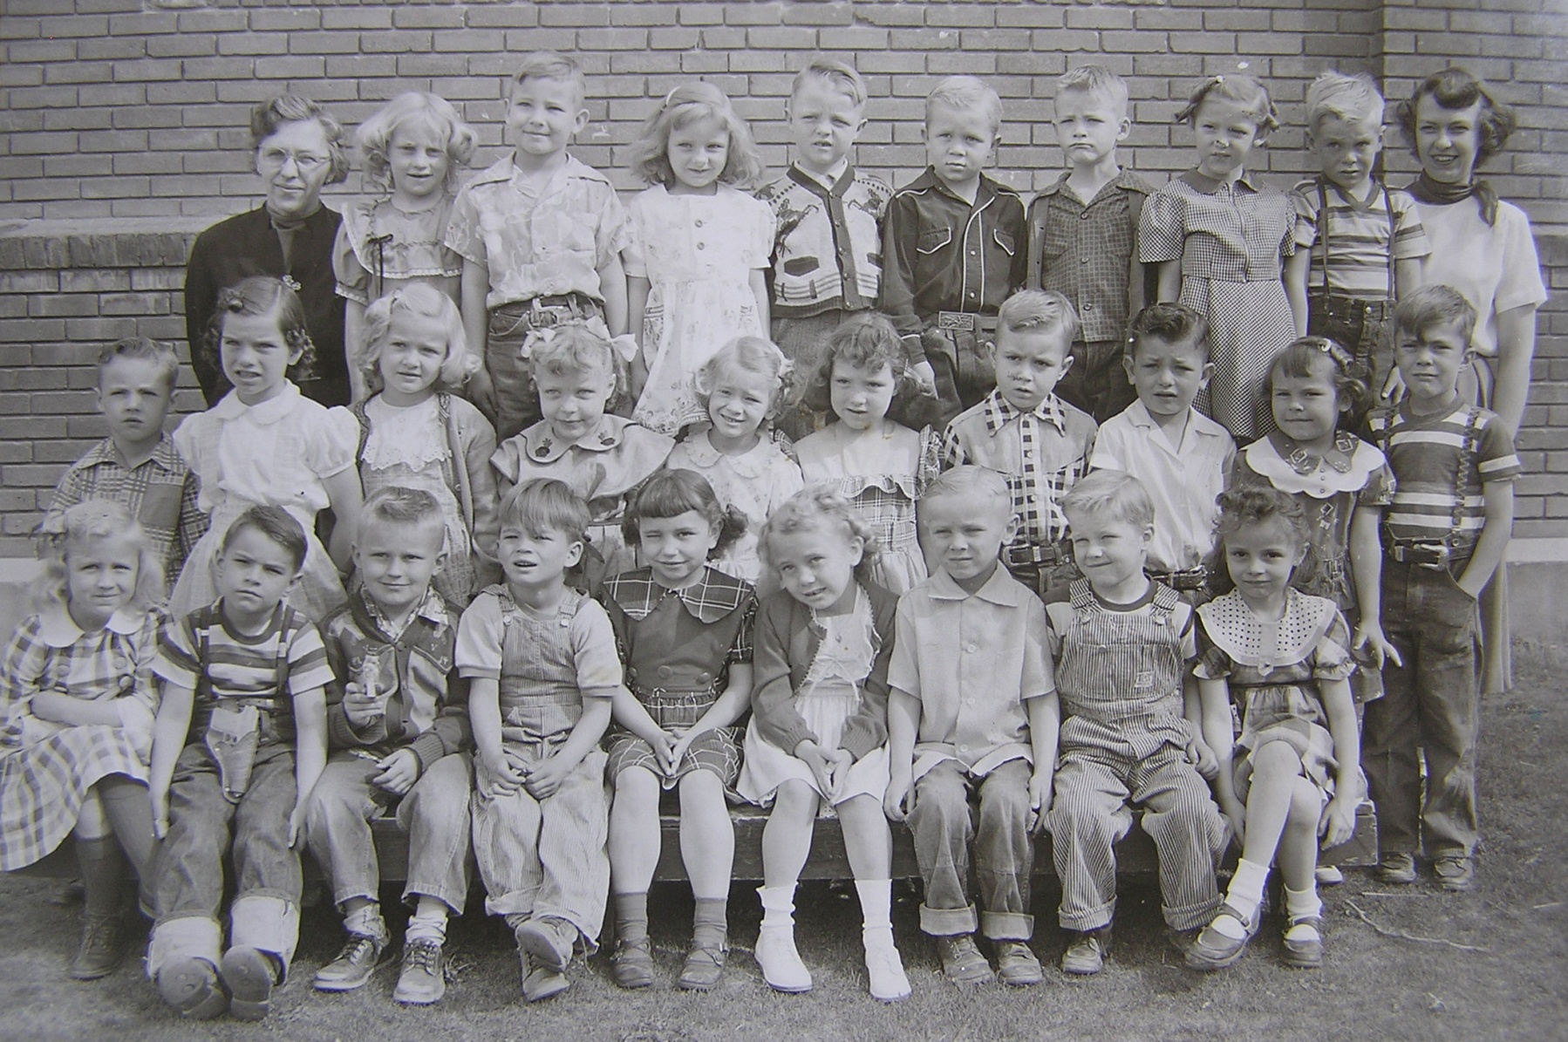
Kindergarten - Morning - Lee & Pershon, Rees Elementary 1952-53, Spanish Fork, Utah
Front l to r: Shanna Rae Shepherd, Nelson Hatch, Ronald Hatfield, Frankie Rowe, Connie Knotts, Karma Jane Finch,
Bruce Hawkins, Douglas Shepherd, Sherry Willis 2nd: Sterling Spencer, Julie Christensen, Marie Tuttle, Joylyn Tanner,
Marilyn Bauer, Judy Romero, Kelly Crabb, Mickey Braithwaite, Susan Hales, David Ellison 3rd: Mrs. Lee, Barbara Ewell,
Larry Hathaway, ___3/5th____ , Reed Webb, Douglas Erickson, Clyde Johnson, LaRayne Baum, Roger Fuller, Miss Pershon

Slide 32
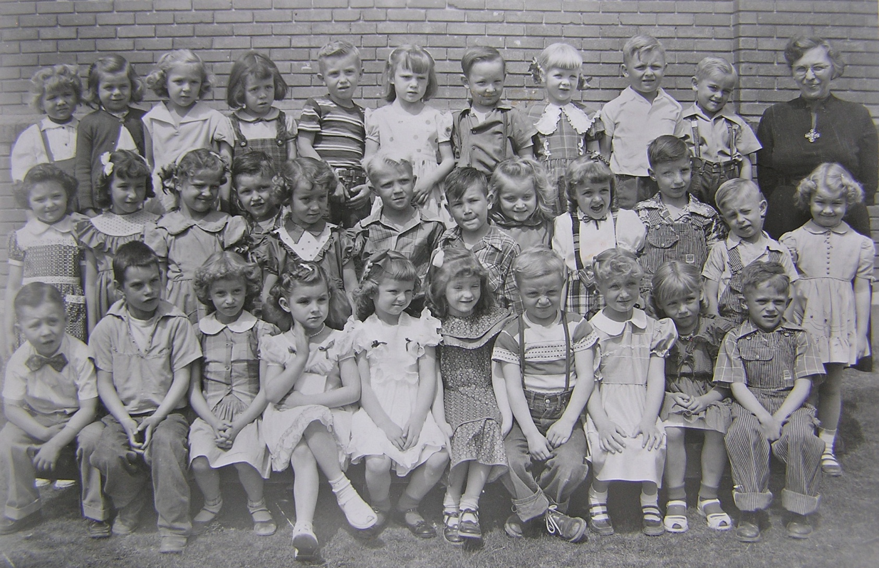
Kindergarten - Afternoon - Lee, Rees Elementary 1952-53, Spanish Fork, Utah
Front l to r: Lloyd Evans, Jerry Robertson, Barbara Ainge (?), Rhea Warner , Bonnie Ann Brown, Lorna Byron,
Grant Davidson, Annette Searle, Marilyn Clark, Stanley ? 2nd: Mary Carol Taylor, Pat Larsen, Marilyn Bauer (?),
___2/4th___ , Nancy Bingham, Bernell Johnson, Glen Memmott, Marilyn McVey, Marie Spencer, Duane Beardall,
Ronald Atwood, Bonnie Bills 3rd: Judy Memmott, ___3/2nd____, 3/3rd____, Joyce Young, Stephen Donaldson,
Diana Delaney, Nolan Hill, Doris Ann Hunter, ___38th___ , Bruce Hayward, Mrs. Lee

Slide 33
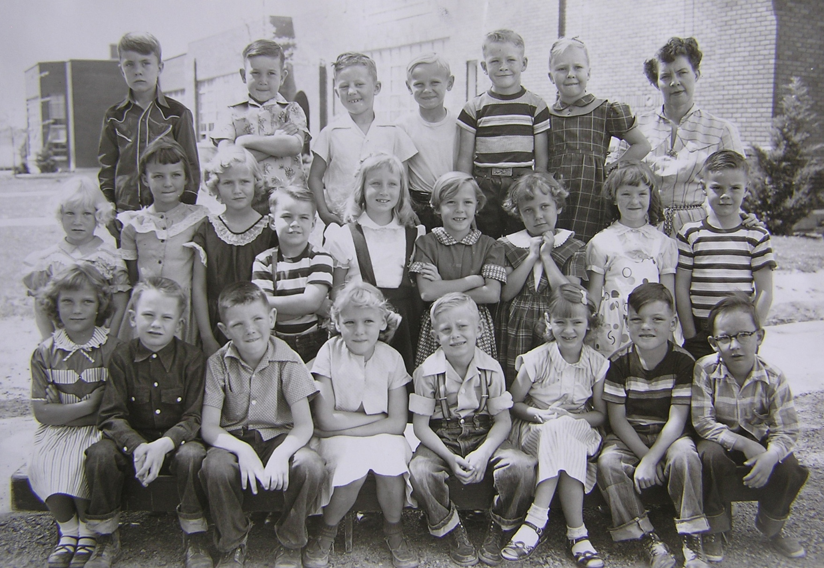
1st Grade - Amstad, Rees Elementary 1953-54, Spanish Fork, Utah
Front l to r: Jana Lee Russell, Lee Christensen, Ronald Dunn, Marilyn Clark, Ronald Atwood, Marilyn Bauer, Paul Smith, Nolan Hill 2nd: Nellie Cope, Marie Clark, Marie Tuttle, Nelson Hatch, Annette Searle, __2/6th____ ,
Karma Jane Finch, Lorna Byron, Keith Lyman 3rd: David Ellison, Glen Memmott, __3/3rd____ , Bruce Hawkins,
Clyde Johnson, Evelyn Peterson, Mrs. Amstad.

Slide 34
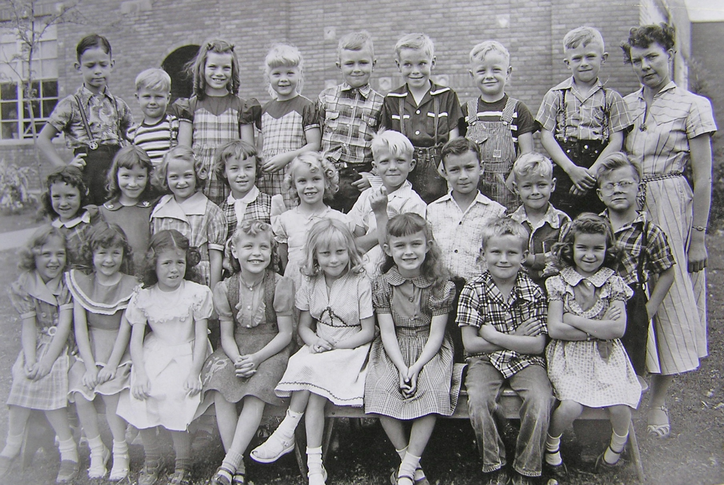
1st Grade – Amstad (2), Rees Elementary 1953-54, Spanish Fork, Utah
Front l to r: Lois Christensen, Janice Nileson, Joyce Young, Joy Lynn Tanner, Barbara Ewell, VeeAnna Lee Spencer,
Ronnie Hatfield, Renee Smith 2nd: Judy Kay Romero, Patsy Larsen, Lacy Christensen, Nancy Bingham, Julie Barney,
Bernell Johnson, Rodney Dart, Ernie Walker, Freddie _____ 3rd: Paul Durrant, Douglas _____, Julie Christensen,
Ann Hunter, Kelly Crabb, Roger Fuller, Grant Davidson, Stanley _____ Mrs. Amstad

Slide 35
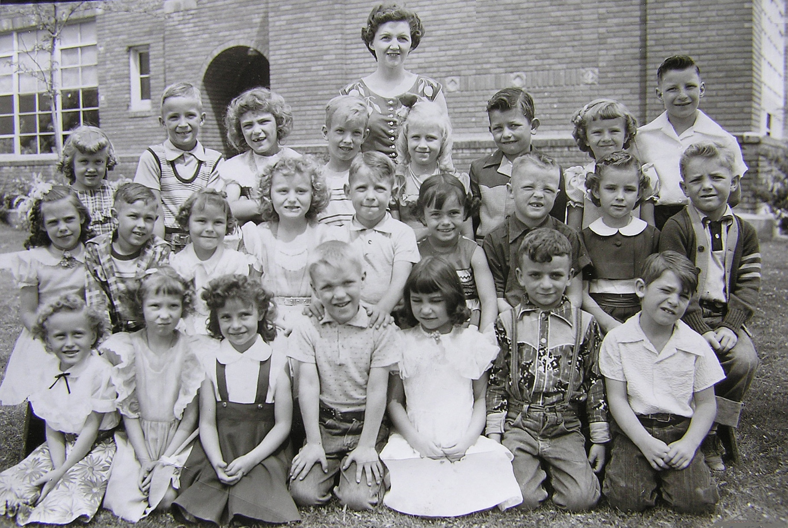
1st Grade – Question (3), Rees Elementary 1953-54, Spanish Fork, Utah
Front l to r: Sally Thomas , LaRayne Baum , Sherry Willis , ___1/4___ , Connie Knotts, David Pace, ___1/7___
2nd: Mary Ellen Dudley, ____2/2____ , Susan Hales, Marilyn McVey, Richard Huff, ____2/6____ , Reed Webb,
Rhea Warner (?) , ___2/9___ 3rd: Lorraine Anderson, Robert Wilson, Eilleen Barney, ____3/4___ ,
Shanna Rae Shepherd, Mickey Braithwaite, Bonnie Brown, Duane Beardall 3rd: Mrs. Hill

Slide 36
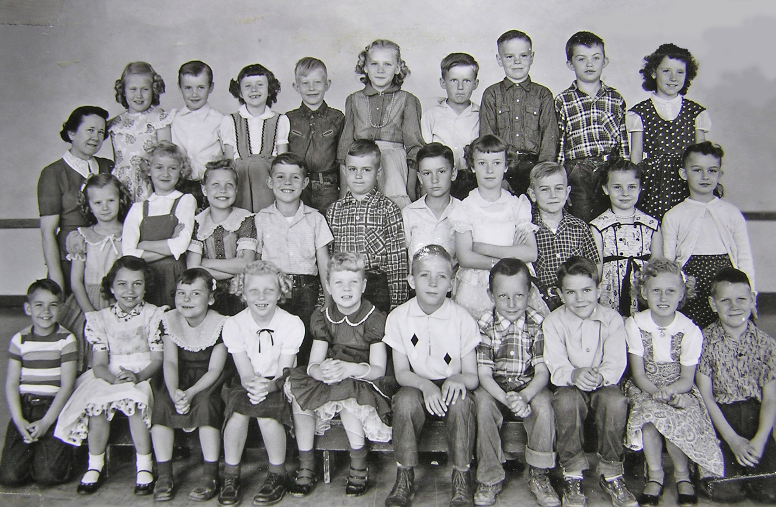
2nd Grade - Bowen, Rees Elementary 1954-55, Spanish Fork, Utah
Front l to r: Nelson Hatch, Connie Knotts, Susan Hales, Linda Whitlock, Doris Ann Hunter, Robert Wilson, Nolan Hill,
Martin Fullmer, Sally Thomas, Johnny Strange 2nd: Bonnie Ann Brown, Marie Tuttle, Joylyn Tanner, Richard Huff, Kelly Crabb,
Rodney Dart, Nancy Bingham, Bruce Hayward, Sherry Willis, V. Anna Lee Spencer 3rd: Miss Pat Bowen, Lorraine Anderson,
Sterling Spencer, Janice Nelson, Ronald Atwood, Marilyn Clark, Ronald Hatfield, Keith Lyman, Edward Abbott, Judy Kay Romero

Slide 37
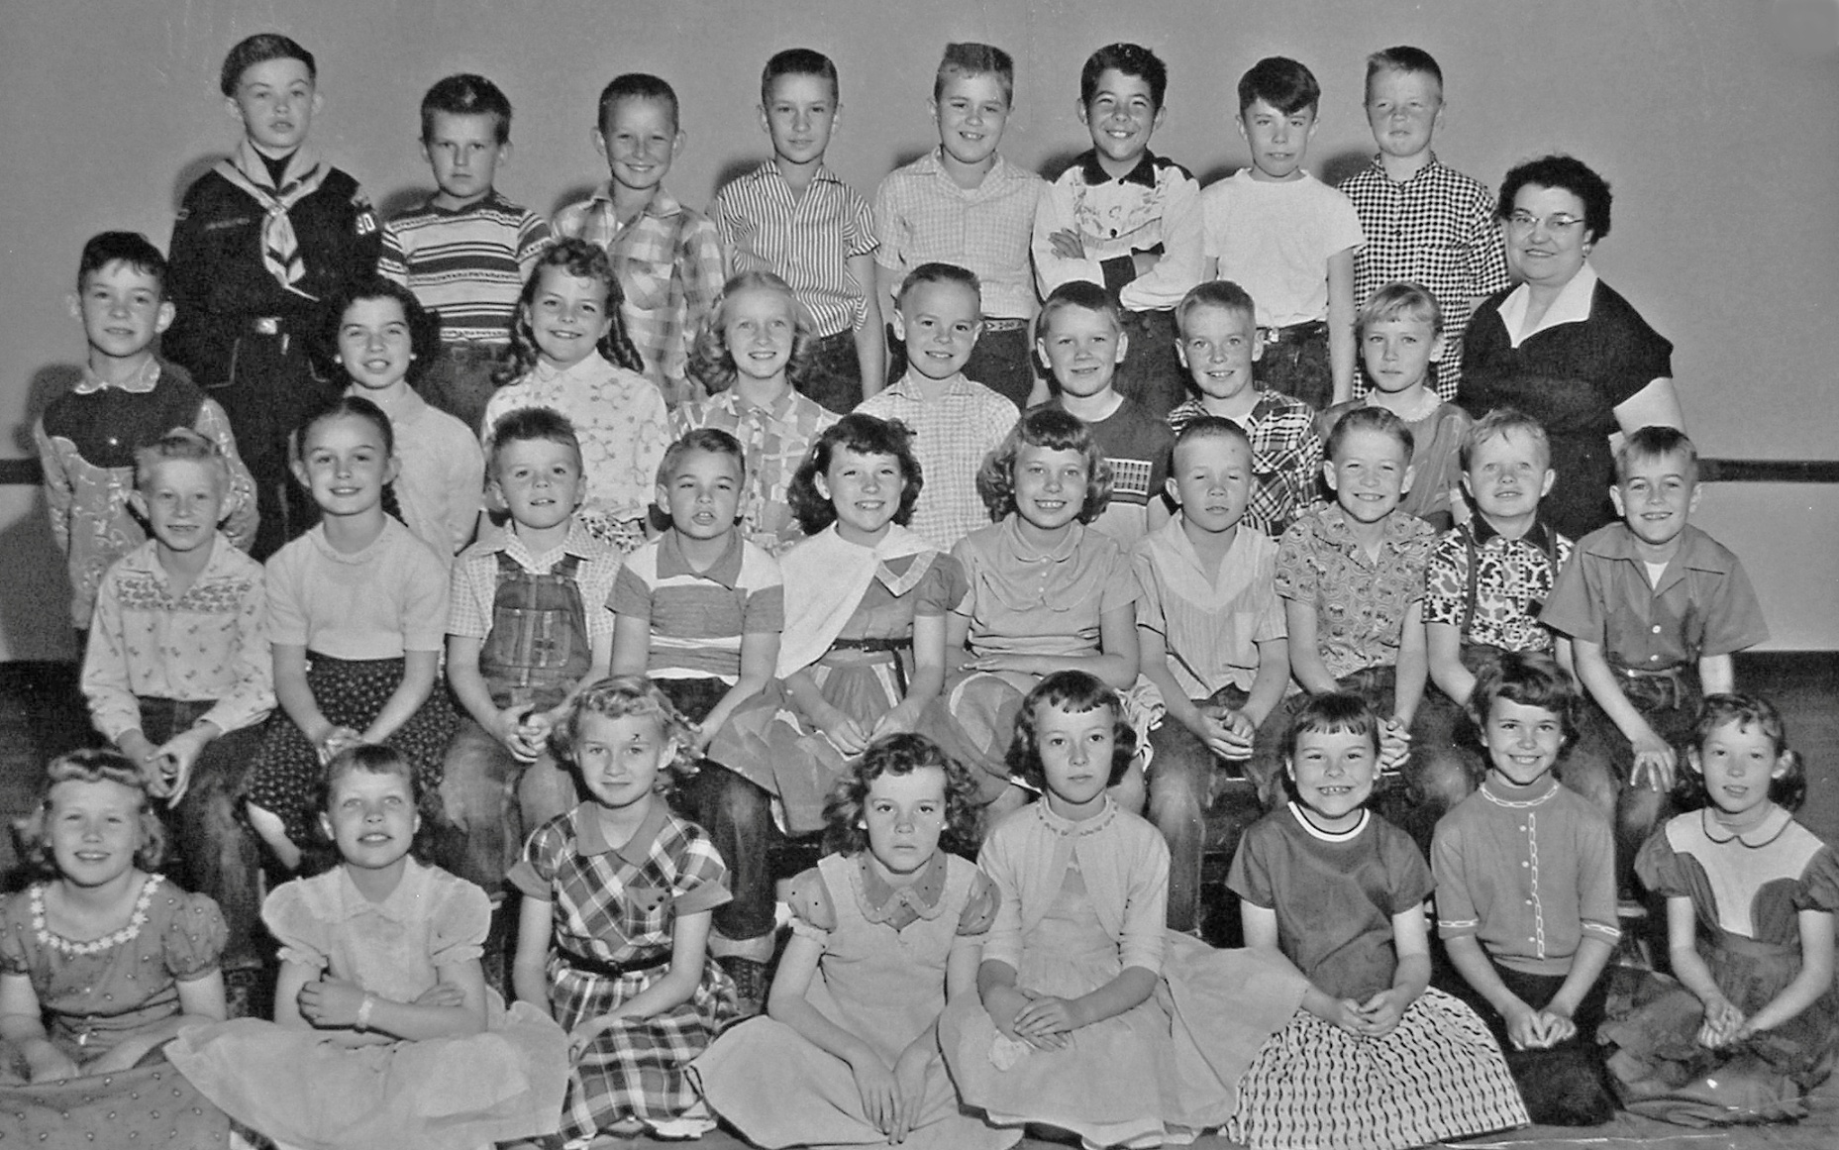
3rd Grade - Hansen, Rees Elementary 1955-56, Spanish Fork, Utah
Front l to r: Lorraine Anderson, Joylyn Tanner, Marie Tuttle, Diana Delaney, Nancy Bingham, Susan Hales, Colleen Dunn,
LaRayne Baum 2nd: Ronald Atwood, V. Anna Lee Spencer, Ronald Dunn (?), Nelson Hatch, Judy Kay Romero,
Karma Jane Finch, Douglas Erickson, Clyde Johnson, Grant Davidson, Bruce Hayward 3rd: Paul Durrant, Julie Christensen,
Marie Spencer, Annette Searle, Keith Lyman, Johnny Strange, Roger Fuller, Marilyn Clark, Miss Mary Ann Hansen
4th: Edward Abbott, Ronald Hatfield, Nolan Hill, Rodney Dart, Kelly Crabb, Tony Gonzalez, David Ellison, Reed Webb

Slide 38
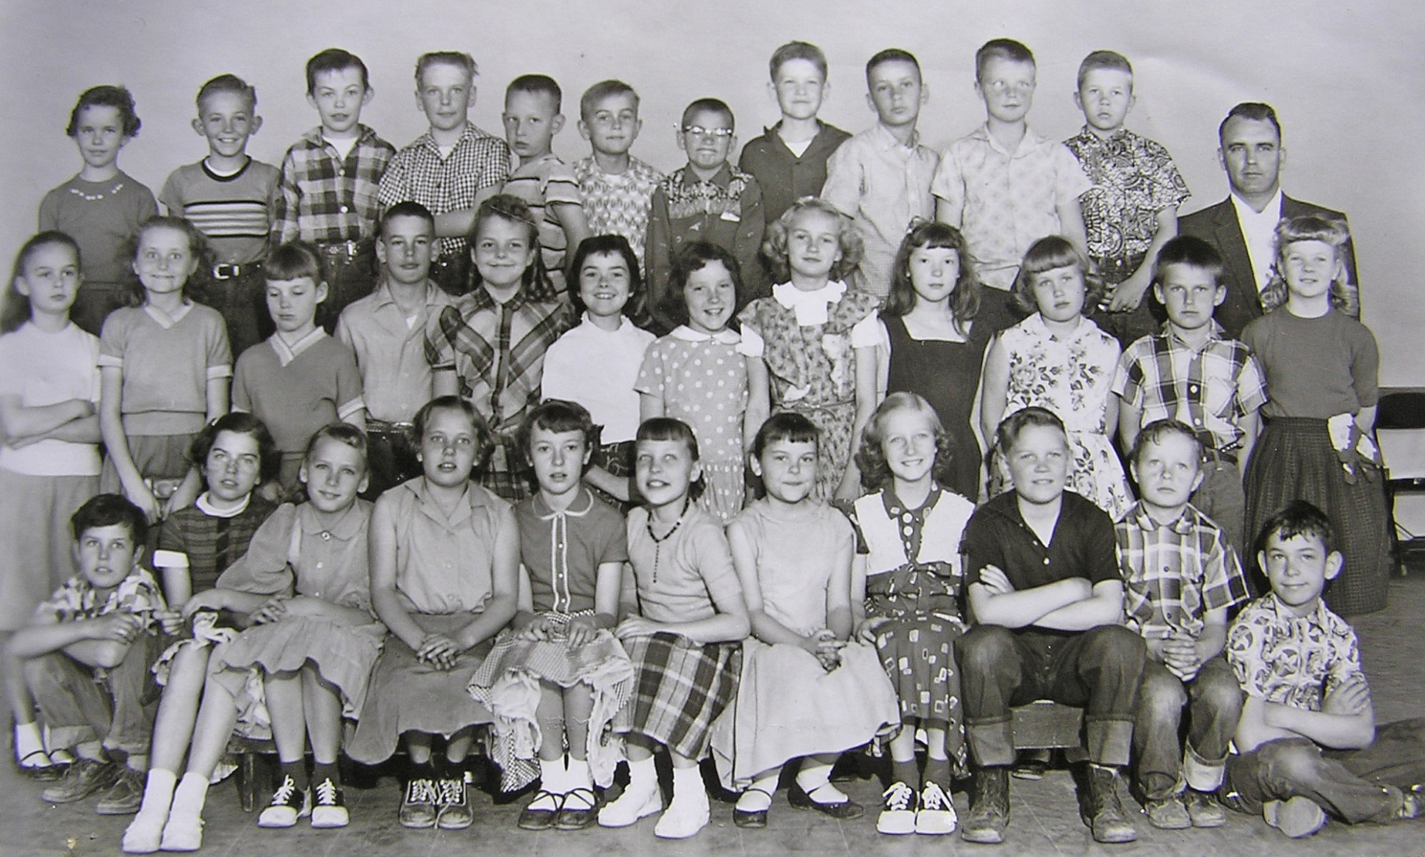
4th Grade - Harris, Rees Elementary 1956-57, Spanish Fork, Utah
Front l to r: Richard Hartvigsen, Julie Christensen, Marilyn Clark, Karma Jane Finch, Nancy Bingham, Joylyn Tanner,
Susan Hales, Annette Searle, Johnny Strange, Grant Davidson, Paul Durrant 2nd: V. Anna Lee Spencer, Marilyn McVey,
Diana Delaney, Jerry Robertson, Marie Spencer, Arlene Lowe, Judy Kay Romero, Marie Tuttle, LaRayne Baum,
Lorraine Anderson, Ronald Hatfield, Doris Ann Hunter 3rd: Colleen Dunn, Stephen Donaldson, Edward Abbott, Roger Fuller,
Nolan Hill, Bruce Hayward, Nelson Hatch, Clyde Johnson, Rodney Dart, Reed Webb, Douglas Erickson, Mr. Grant Harris

Slide 39
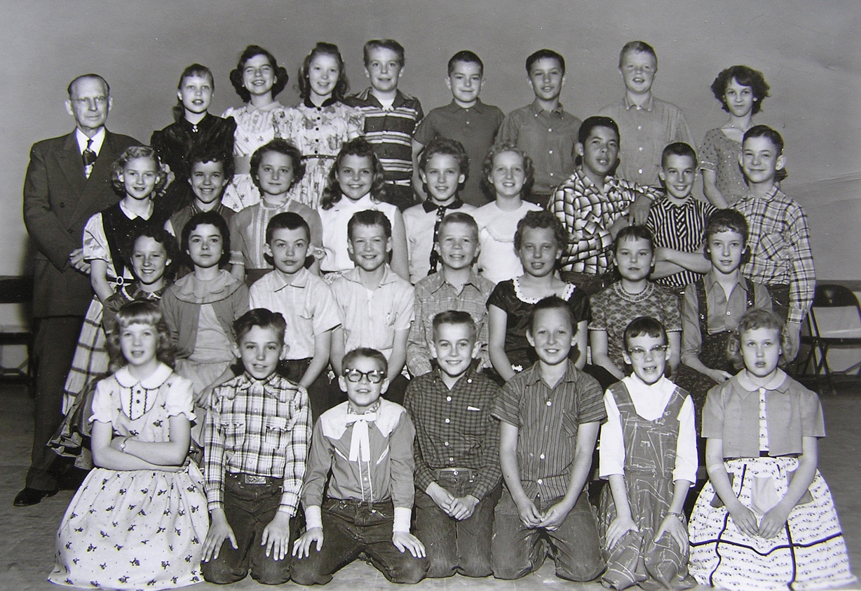
5th Grade - Faux, Rees Elementary 1957-58, Spanish Fork, Utah
Front l to r: Ann Hunter, Steven Johnston, Nelson Hatch, Bruce Hayward, Nolan Hill, Diana Delaney
Lorraine Anderson 2nd: Judy-Kay Romero, Arlene Lowe, Eddie Abbott, Clyde Johnson, Doug Erickson,
Karma Finch, Susan Hales, Nancy Bingham 3rd: Marie Tuttle, Colleen Dunn, Marilyn McVey, Marie Spencer,
Marilyn Clark, Annette Searle, Tony Gonzalez, Jerry Robertson, Paul Durrant 4th: Mr. Faux, Joylyn Tanner,
Julie Christensen, LaRayne Baum, Roger Fuller, Larry Linde, Rod Dart, Reed Webb, Glenda Campbell

Slide 40
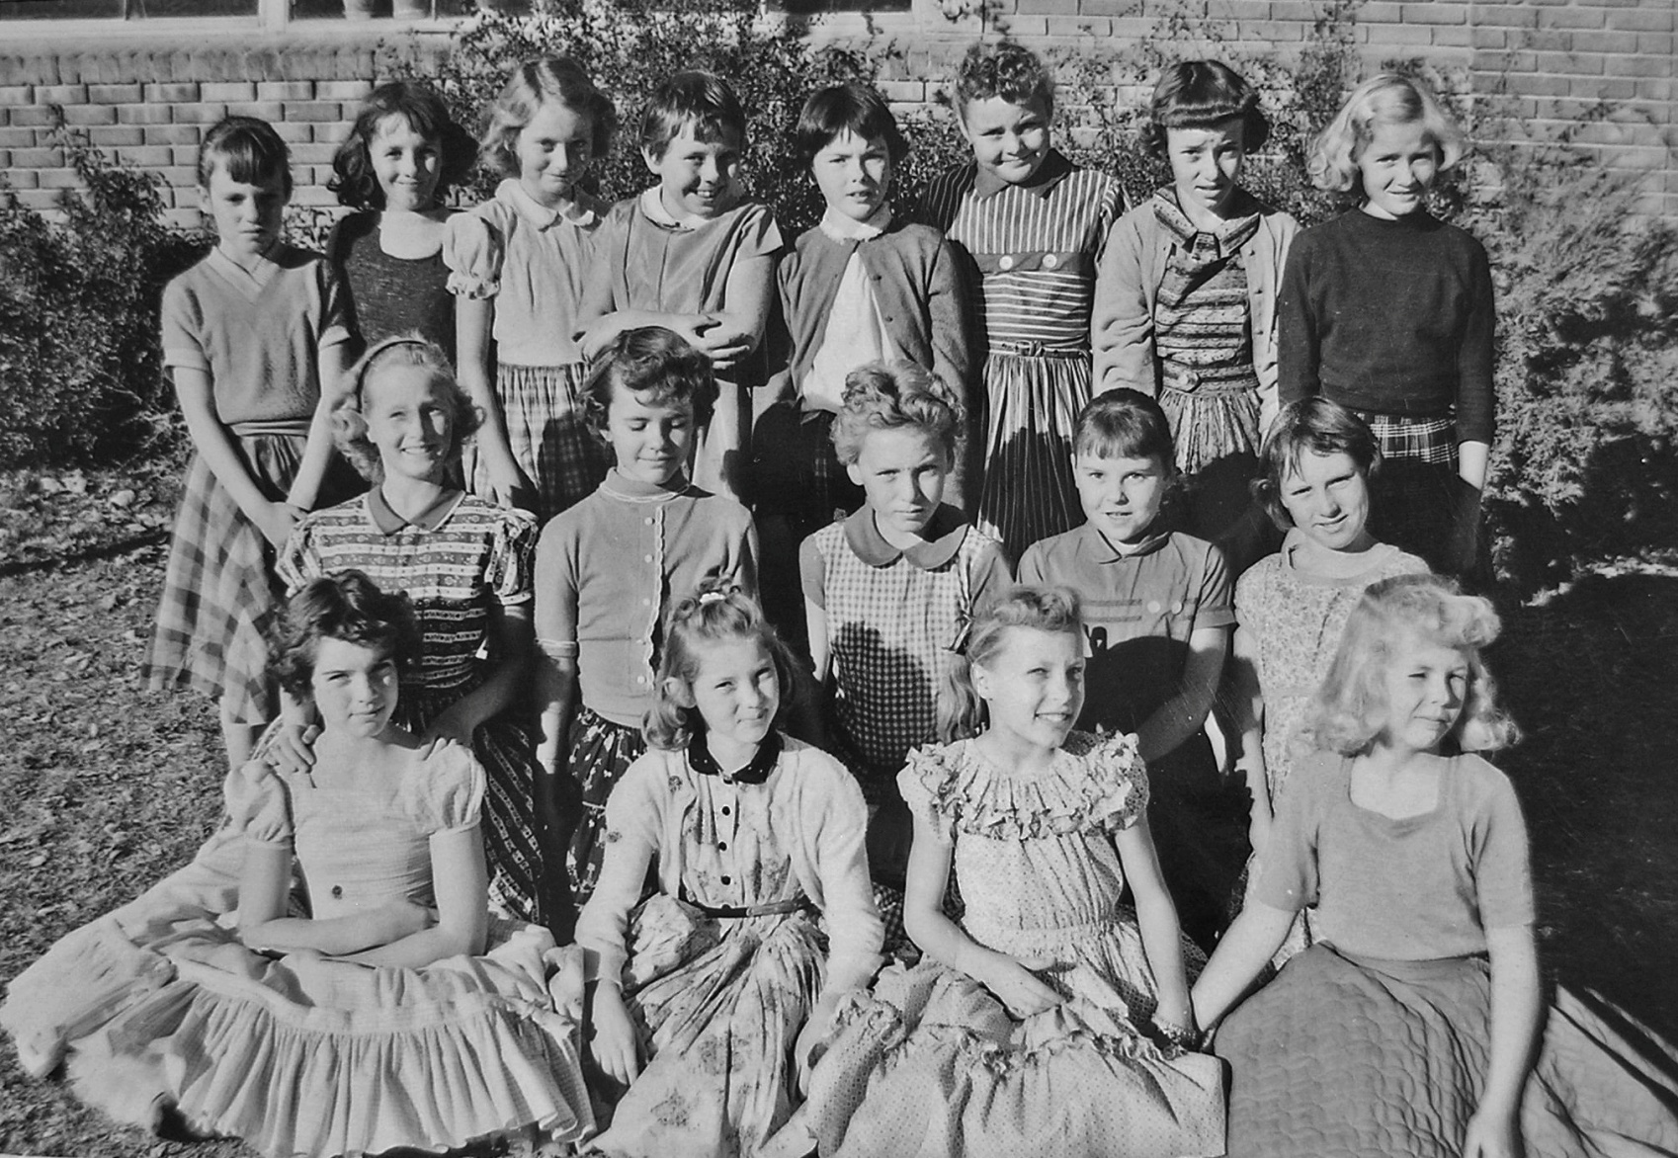
5th Grade Girls - Faux, Rees Elementary 1957-58, Spanish Fork, Utah
Front l to r: Julie Christensen, LaRayne Baum, Joylyn Tanner, Doris Ann Hunter 2nd: Annette Searle,
Colleen Dunn, Marilyn Clark, Susan Hales, Judy Kay Romero 3rd: Diana Delaney, Glenda Campbell,
Marilyn McVey, Karma Jane Finch, Arlene Lowe, Marie Spencer, Nancy Bingham, Marie Tuttle (Teacher: Mr. Faux)

Slide 41
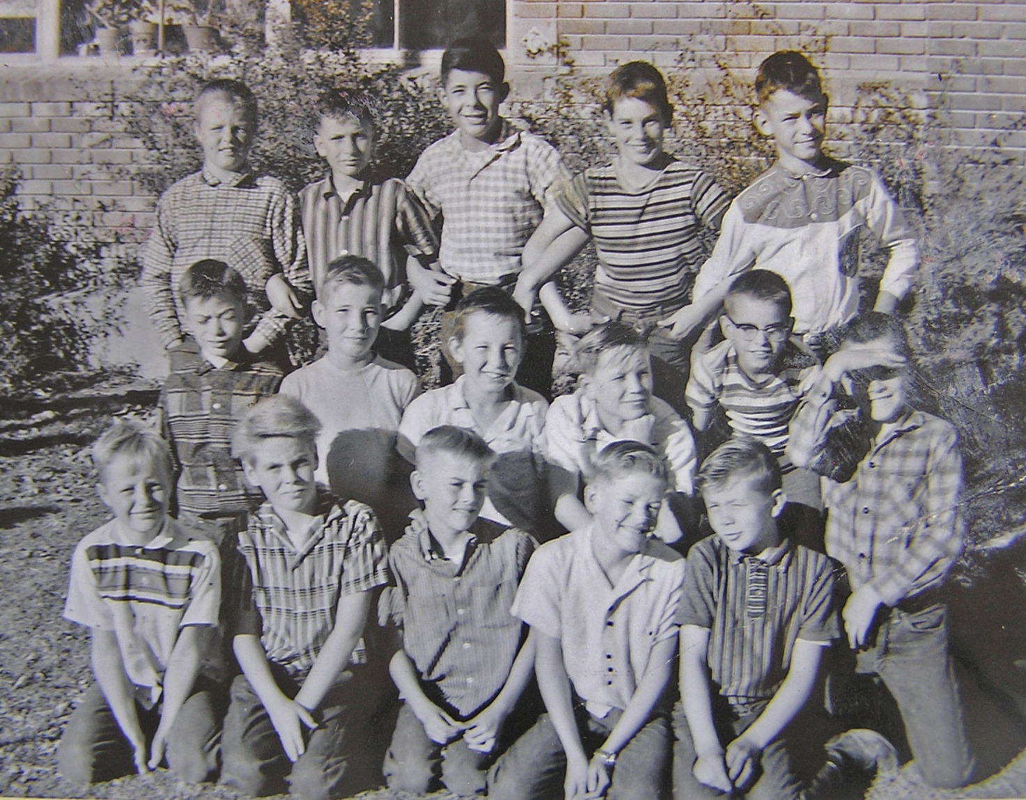
5th Grade Boys - Faux, Rees Elementary 1957-58, Spanish Fork, Utah
Front l to r: Grant Davidson, Roger Fuller, Bruce Hayward, Clyde Johnson, Douglas Ericksen
2nd: Edward Abbott, Larry Hathaway, Nolan Hill, Johnny Strange, Nelson Hatch, Larry Linde,
3rd: Reed Webb, Rodney Dart, Tony Gonzalez,Jerry Robertson, Paul Durrant (Teacher: Mr. Faux)

Slide 42
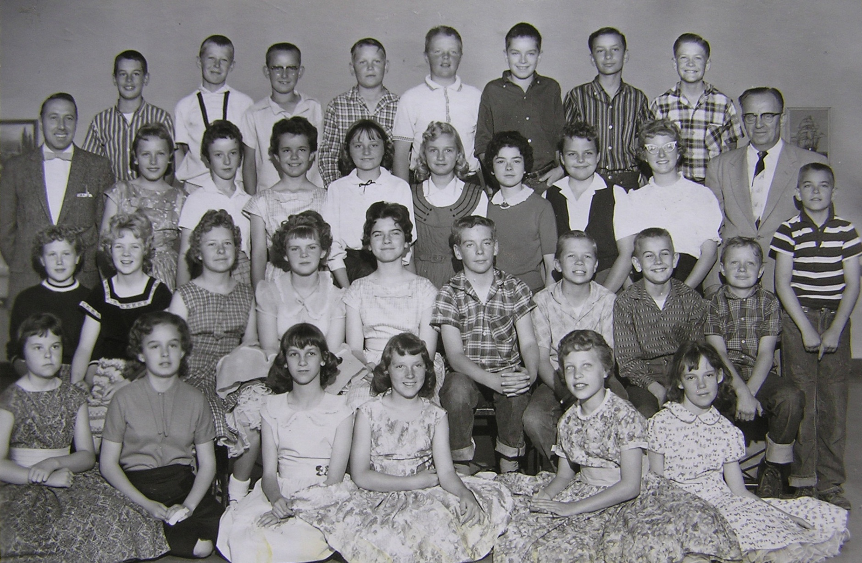
6th Grade – Jex & Peterson, Rees Elementary 1958-59, Spanish Fork, Utah
Front l to r: Susan Hales, V. Anna Lee Spencer, Glenda Campbell, Judy Kay Romero, Joylyn Tanner, Diana Delaney,
2nd: Lorraine Anderson, Doris Ann Hunter, Evelyn Peterson, Lynnette Winters, Julie Christensen, Roger Fuller,
Douglas Ericksen, Bruce Hayward, Grant Davidson, Nelson Hatch 3rd: Mr. Melvin Jex, Marilyn Clark, Nancy Bingham,
Colleen Dunn, Marilyn McVey, Marie Tuttle, Arlene Lowe, Marie Spencer, Annette Searle, Mr. Raymond Peterson
4th: Jerry Robertson, Merrill Diamond, Nolan Hill, Johnny Strange, Reed Webb, Larry Linde, Rodney Dart, Clyde Johnson

Slide 43
Salem Elementary School
Salem, Utah

Slide 44
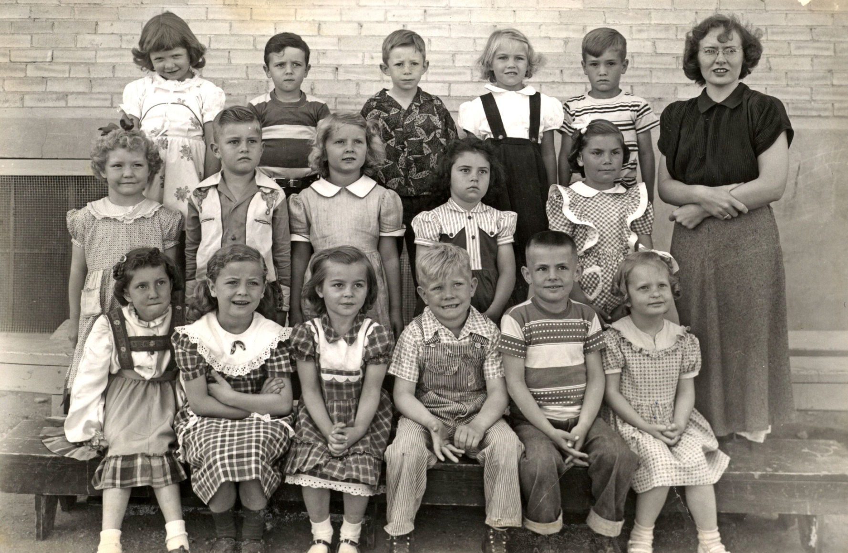
Kindergarten - Allred, Salem Elementary 1952-53, Spanish Fork, Utah
Front l to r: Ronda Jean Crist, Maurine Jensen, Elaine Christensen, Mack Gardner, Greg Christensen,
Elainey Walton 2nd: Rinda Blad, Richard Orton , Vicky Sabin, Mary Lee Christensen, Phyllis Davis
3rd: Sharon Taylor, Del Jorgensen, Paul Nelson, Orthella Horrocks, Johnny Davis, Mrs. Allred

Slide 45
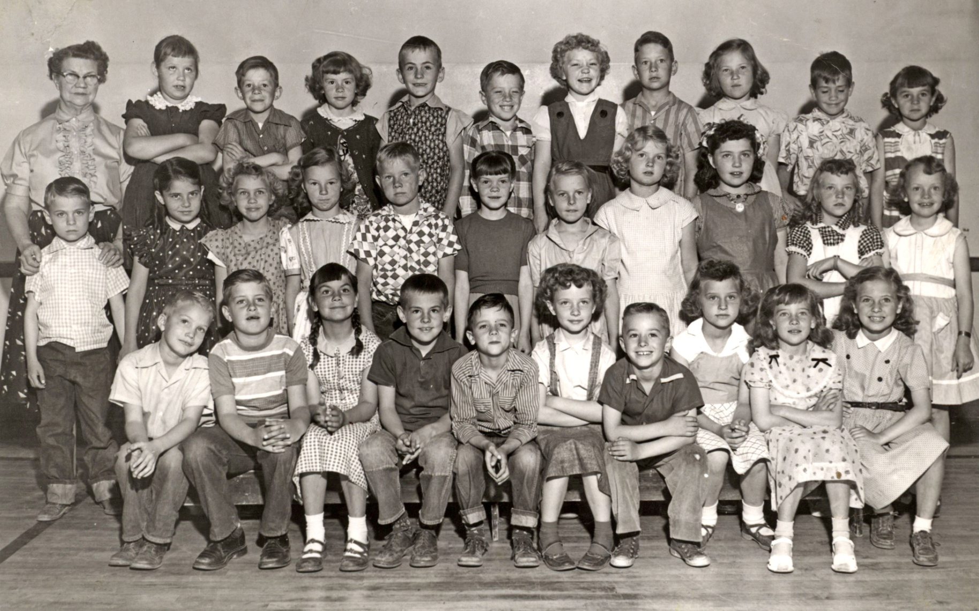
1th Grade - Larsen, Salem Elementary 1953-54, Spanish Fork, Utah
Front l to r: LaGrand Baker, Richard Orton, Phyllis Davis, Greg Christensen, Del Jorgensen, Connie Cloward, Rodney Sperry,
Della Mae Peterson, Pat Morris, Maurine Jensen 2nd: Kurt Hanks, Mary Lee Christensen, Orthella Horrocks, Janet Bahr,
Mack Gardner, Kay Underwood, Pamala Newman, Vicky Sabin, Paula Prince, Mary Selman, Lois Mae Thompson
3rd: Mrs. Larsen, Sharon Taylor, Paul Nelson, Charlene Christensen, Mike Evans, Kurt Lloyd, Rinda Blad, Reed Nelson,
Carolyn Curtis, Johnny Davis, Elaine Christensen,.

Slide 46
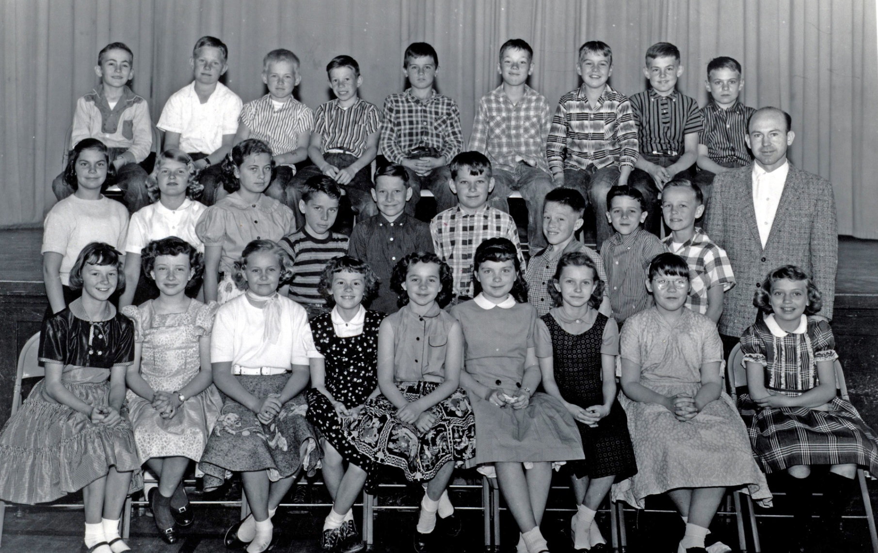
5th Grade - Goodrich, Salem Elementary 1953-53, Spanish Fork, Utah
Front l to r: Janet Bahr, Connie Cloward, Kathleen Miller, Charlene Christensen, Elaine Christensen, Della Lynn Christensen,
Sharon Moore, Sharon Taylor, LaRayne Dayton 2nd: Phyllis Davis, Vicky Sabin, Maurine Jensen, Garth Linton, Reed Nelson,
Frank Lake, Kurt Lloyd, Del Jorganson, Sam Christensen 3rd: Mike Evans, Mack Gardner, Doug Johnson, Paul Nelson,
Allen Jones, Jimmy Gardner, Earl Dempson, Greg Christensen, Kurt Hanks, Mr. Goodrich

Slide 47
Thurber Elementary School
Spanish Fork, Utah

Slide 48
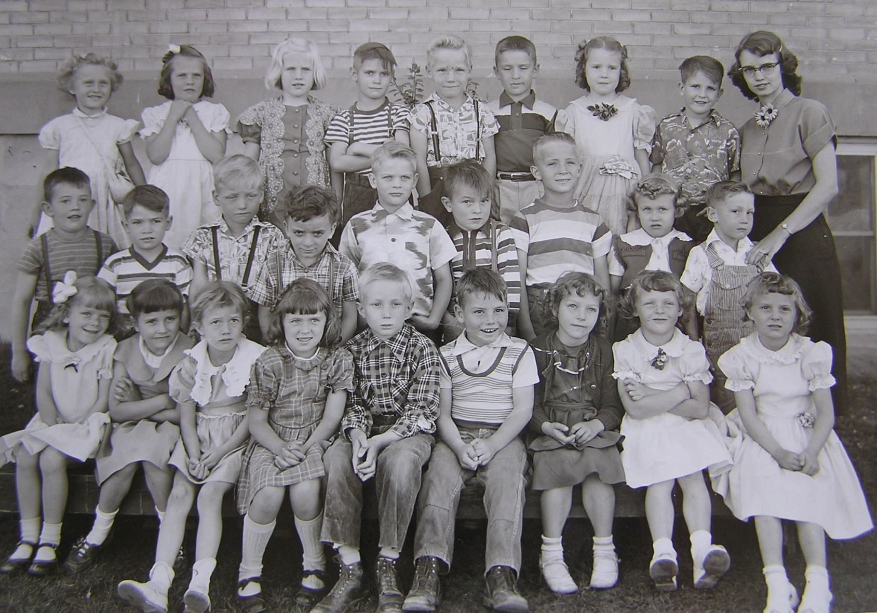
Kindergarten - Afternoon - Fish, Thurber Elementary 1952-53, Spanish Fork, Utah
Front l to r: ___1/1st___ , Kristin Losser , Renee Ridgley?, ___1/4th___ , Del Stewart, Ricky Thomas,
Jana Lee Russell , Linda Corbett, ___1/9th___ , 2nd: Milton Moody, ___2/2nd___ , Roy Vincent , David Pace ,
___2/5th___ , Brent Bills, Robert Wilson, Lorraine Anderson, ___2/9th___ 3rd : Sally Thomas, Mary Ellen Duddley ,
___3/3rd___ , Martin Petersen , Ray Vincent, Rodney Dart , Camille Francis, Dennis Martin, Miss Fish

Slide 49
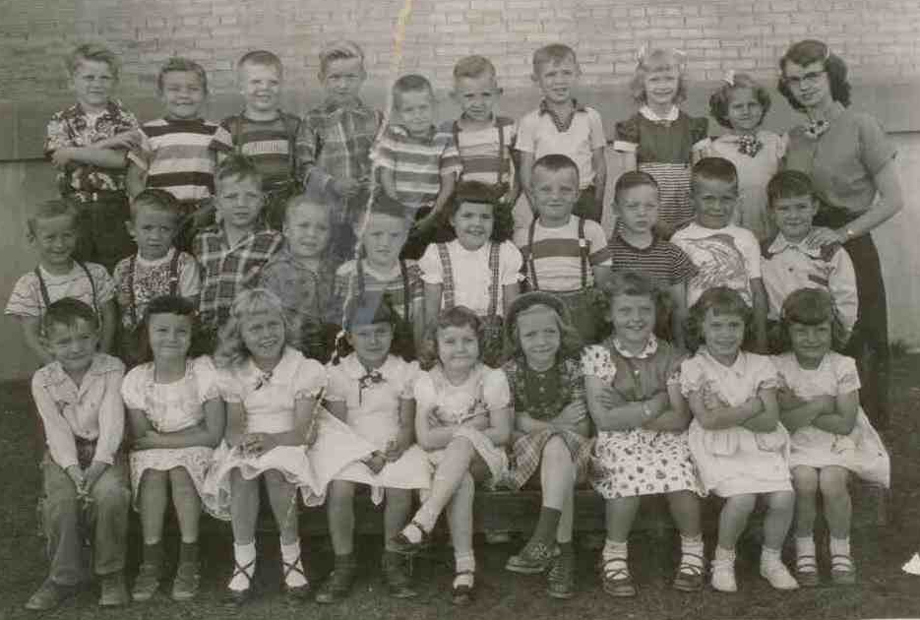
Kindergarten - Morning - Fish, Thurber Elementary 1952-53, Spanish Fork, Utah
Front l to r: Duane Ludlow, Patty Swenson, Judy Darling, Diane Gull, Joan Ludlow, Dianne Warner,
Kay Marie Isaac, Diane DeGraw, Kathleen Johnson, 2nd: Dennis Bradford, Steven Cloward, Jimmy Stabler,
Dennis Holley, Steven Isaac, J’Net Hughes, Reid Goodlief, Henry Barnes, ___2/9th___, Brent Bills
3rd : Bryan Jex, Sterling Lewis, Wayne Pace, ____3/4th____, Danny Gull, Steve Johnston, ___3/6th___,
Suanne Alleman, Sherry Lynn Warner, Miss Fish

Slide 50
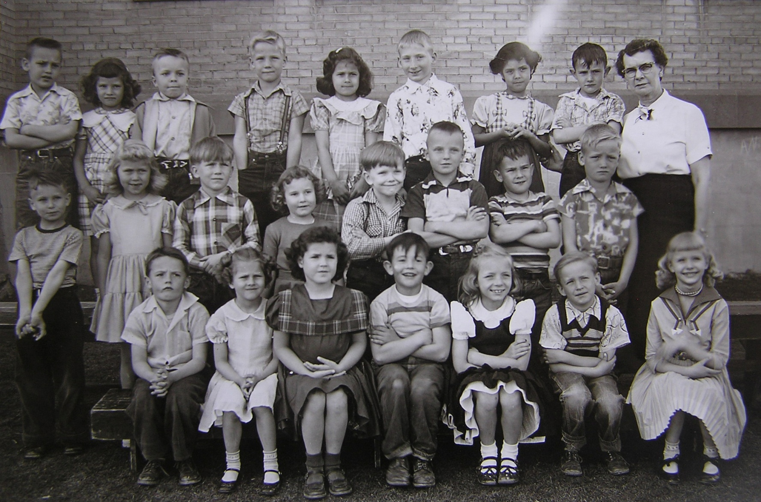
1st Grade - Hansen, Thurber Elementary 1953-54, Spanish Fork, Utah
Front l to r: Steven Isaac, Sherry Lynn Warner, J’Net Hugh, Milton Moody, Diane Warner, Dennis Bradford
Suanne Alleman 2nd: Danny Gull, Judy Darling, Bryan Jex, Joan Ludlow, John Jex, Reid Goodlief, Brent Bills
Roy Vincent 3rd : Brent Moore, Kathleen Johnson , Dennis Holly, Ray Vincent , Diane Gull, Joel Volsky
Mary Tajillo, Duane Ludlow, Mrs. Hansen

Slide 51
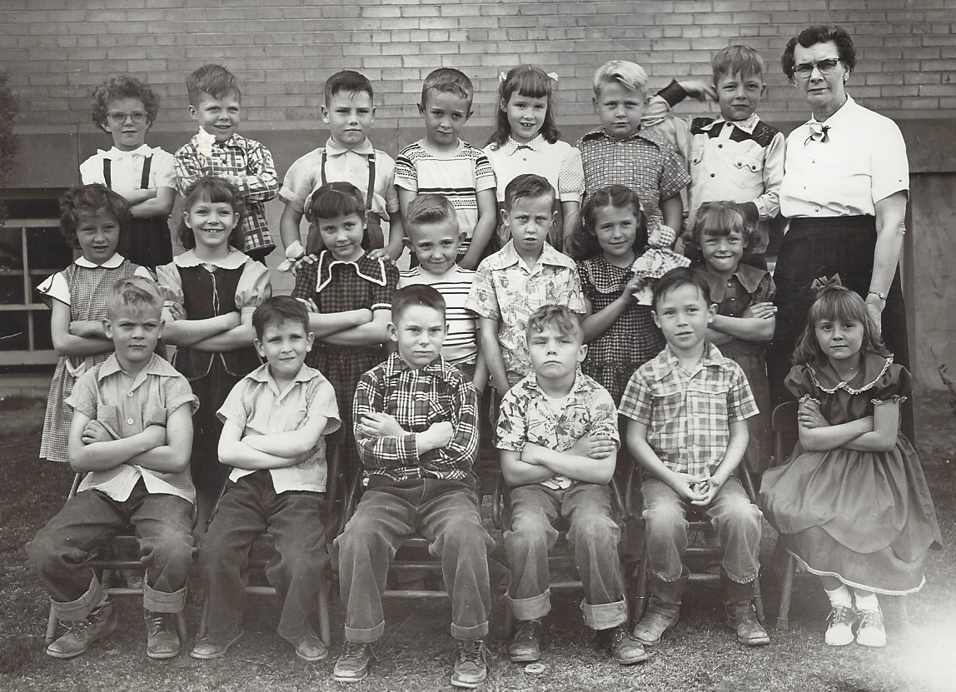
1st Grade – Hansen (2), Thurber Elementary 1953-54, Spanish Fork, Utah
Front l to r: ___1/1___, Dennis Martin, ____1/3____, Sterling Lewis, ____1/5____, ____1/6____
2nd: Karen Prince, ___2/2___, Kristin Losser, Steve Johntson, Buddy Gabbitis, ___2/6___, Linda Corbett
3rd : Elaine McKell, Wayne Pace, Ricky Thomas, Steven Cloward, Camille Francis, Garth Huff
Jimmy Stabler, Mrs. Hansen

Slide 52
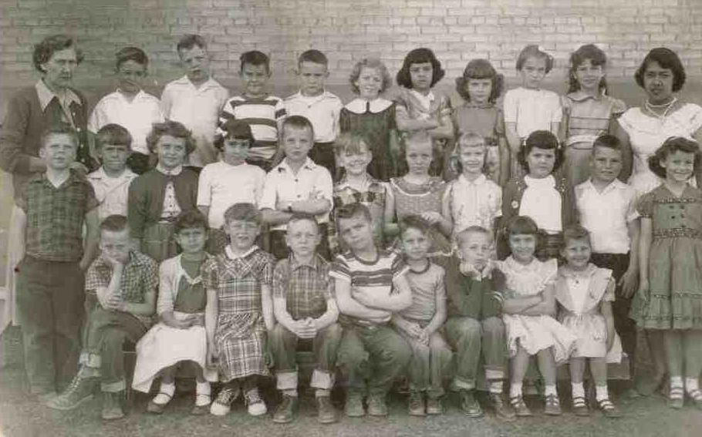
2nd Grade - Brown, Thurber Elementary 1954-55, Spanish Fork, Utah
Front l to r: Dennis Gabbitis, Diane Gull, Linda Corbett, Henry Barnes Sterling Lewis, Danny Gull, Dennis Bradford,
Diane DeGraw, Sherry Lynn Warner 2nd: Wayne Pace, Bryan Jex, Kay Marie Isaac, DeAnne Warren, Reid Goodlief,
Coop Jex, Dianne Warner, Suanne Alleman, J'net Hughes, Ricky Thomas, Patty Swenson 3rd : Mrs. Brown,
Steve Cloward, Jimmy Stabler, Brent Bills, Duane Ludlow, RoseMary Jensen, Mary Trujillo, Kathleen Johnson,
Adele Ward, ___3/10th__, Student Teacher

Slide 53
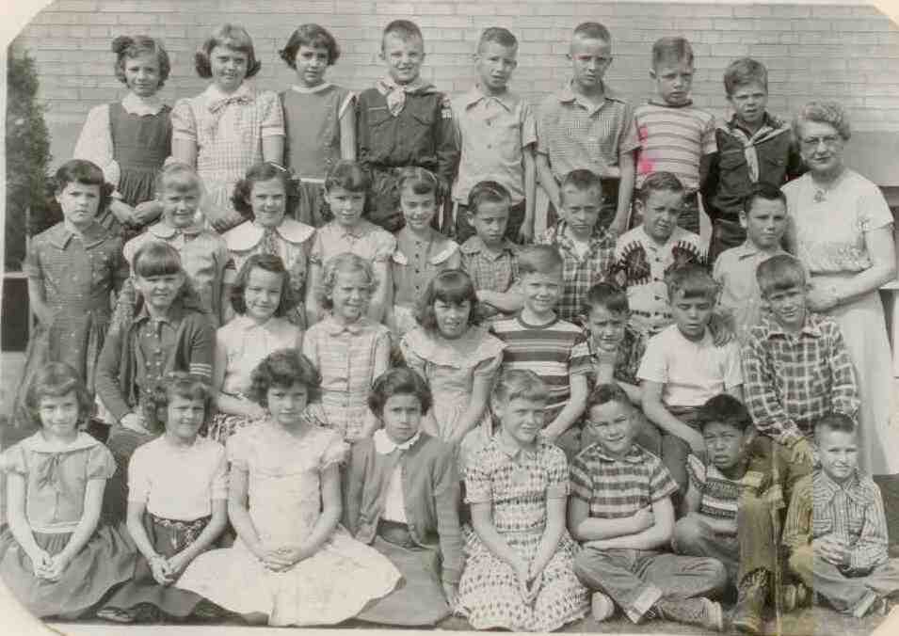
3rd Grade - Eggertson, Thurber Elementary 1955-56, Spanish Fork, Utah
Front l to r: Diane DeGraw, Sherry Lin Warner, Kathleen Johnson, Diane Gull, Linda Corbett, Earnie Wallace,
Danny Gull 2nd: Lynnett Winters, Patty Swenson, Rosemary Jensen, Laurel Young, Coop Jex, Duane Ludlow,
Sterling Lewis, Bryan Jex 3rd : J'net Hughes, Suanne Alleman, Mary Ellen Dudley, Camille Francis, Adele Ward,
Buddy Gabbitis, Henry Barns, Steve Cloward, Ricky Thomas 4th: Dianne Warner, Kaye Marie Isaac, DeAnn Warren,
Reid Goodlief , Larry Hathaway, Robert Wilson, Jimmy Stabler, Wayne Pace, Mrs. Eggertson

Slide 54
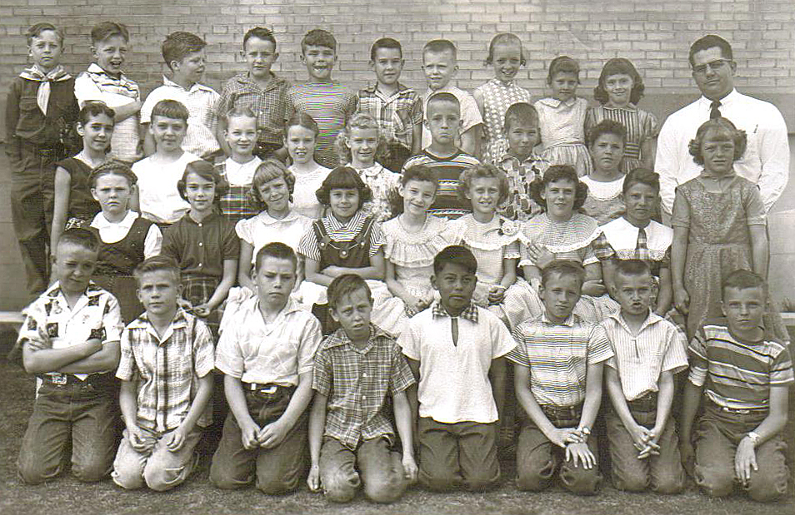
4th Grade - Hanson, Thurber Elementary 1956-57, Spanish Fork, Utah
Front l to r: Steve Cloward, Bryan Jex, Ricky Thomas, Buddy Gabbitas, Ernest Wallace, Dennis Bradford,
Danny Gull, Reid Goodlief 2nd: Lynnett Winters, Adele Ward, Rosemary Jensen, Diane Gull, Patty Swenson,
Sally Thomas, Mary Ellen Dudley, Kathleen Johnson, 3rd : DeAnne Warren, Kay Marie Isaac, Connie Knuteson,
Camille Francis, Suanne Alleman, Robert Wilson, Larry Hathaway, J'net Hughes, Linda Corbett 4th: Henry Barnes,
Jimmy Stabler, Wayne Pace, Duane Ludlow, Sterling Lewis, Brent Bills, Coop Jex, Dianne Warner,
Sherry Lin Warner, Diane DeGraw, Mr. Garth Hanson

Slide 55
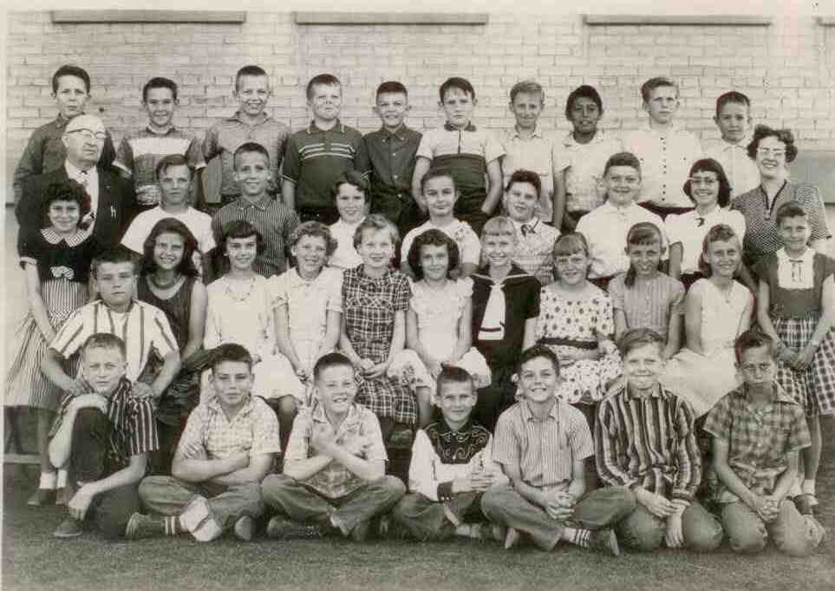
5th Grade - Peterson, Thurber Elementary 1957-58, Spanish Fork, Utah
Front l to r: Henry Barns, Ricky Thomas, Dennis Hicks, Danny Gull, Craig Giles, Coop Jex, Buddy Gabbitas
2nd: Diane Gull, Sterling Lewis, Kathleen Johnson, Adele Ward, Rosemary Jensen, Connie Knuteson, Diane DeGraw,
Suanne Alleman, Linda Corbett, Dianne Warner, Sally Thomas, Sherry Lin Warner 3rd : Mr. Stanley Peterson,
Reid Goodlief, Robert Wilson, Camille Francis, V-Anna Spencer, Mary Ellen Dudley, Kay Marie Isaac, DeAnne Warren,
Mrs. Helen Harris 4th: Frank Kanig, Brent Bills, Jimmy Stabler, Wayne Pace, Reid Nelson, Duane Ludlow,
Dennis Bradford, Ernest Wallace, Bryan Jex, Steve Cloward

Slide 56
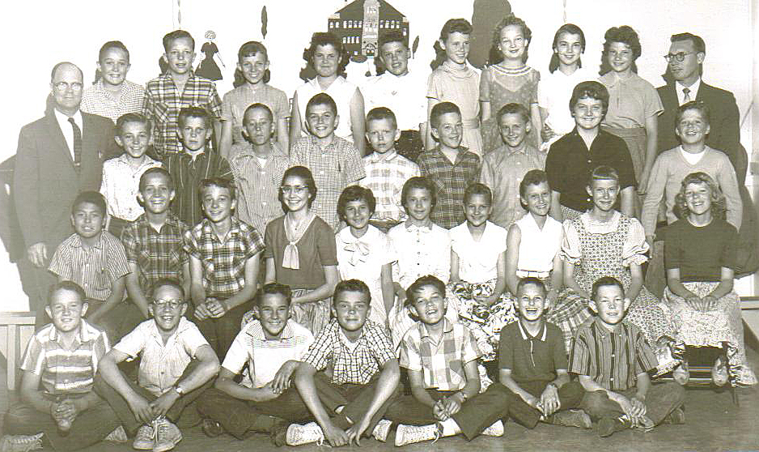
6th Grade - Grotegut, Thurber Elementary 1958-59, Spanish Fork, Utah
Front l to r: Duane Ludlow, Gary Thurston, Brent Bills, Sterling Lewis, Reid Nelson, Danny Gull, Steven Menlove
2nd: Earnie Wallace, Robert Wilson, Henry Barnes, DeAnne Warren, Diane Gull, Diane DeGraw, Sherry Lynn Warner,
Sally Thomas, Suanne Alleman, Rosemary Jensen 3rd : Mr. Grotegut, Steve Johnston, Bryan Jex, Buddy Gabitis, Dennis Hicks,
Jackie Jex, Craig Giles, Dennis Bradford, Kay Marie Isaac, Wayne Pace 4th: Steven Cloward, Jimmy Stabler, Dianne Warner,
J’Net Hughes, Mary Ellen Dudley, Camille Francis, Connie Knuteson, Adele Ward, Kathleen Johnson, Mr. Jack Powell

